Slide 1
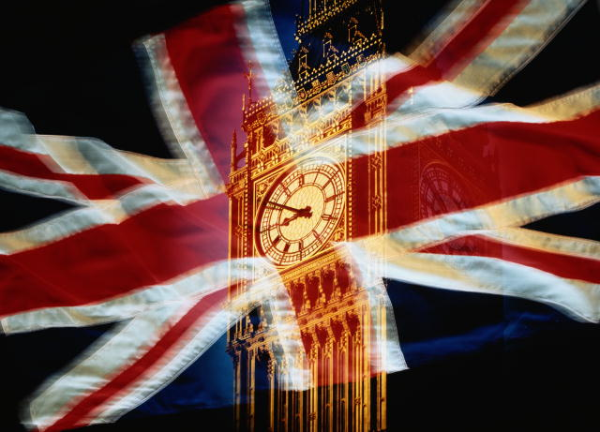
Football stadiums
in Great Britain

Slide 2
Wembley, London

Slide 3
Old Trafford, Manchester

Slide 4
Millennium, Cardiff

Slide 5
Celtic Park, Glasgow

Slide 6
St James' Park,Newcastle upon Tyne

Slide 7
Hampden Park, Glasgow

Slide 8
Ibrox Stadium, Glasgow

Slide 9
Emirates, London

Slide 10
Sunderland Stadium Of Light

Slide 11
City of Manchester Stadium, Manchester

Slide 12
Football fans in Great Britain

Slide 13
Anzhelika Yakymiv 10-A

