Slide 1
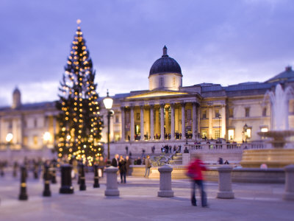
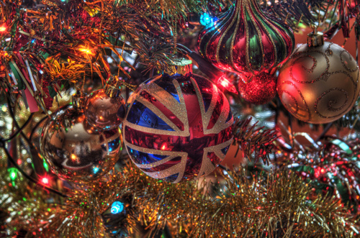
Christmas traditions in England

Slide 2
Content
Christmas in England
Boxing day

Slide 3
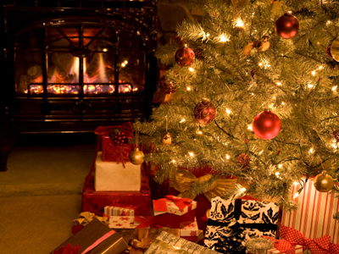
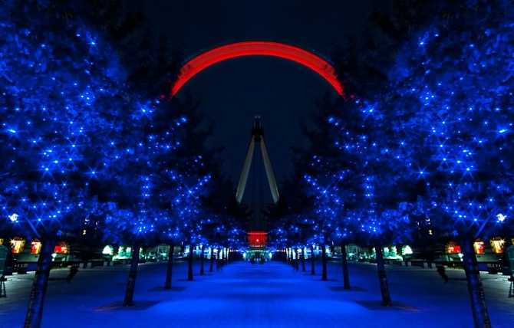
Christmas in England
Christmas is an annual commemoration of the birth of Jesus Christ and a widely observed cultural holiday, celebrated generally on December 25 by millions of people around the world
Christmas is a truly magical season, bringing families and friends together to share the much loved customs and traditions which have been around for centuries. Most people are on holiday in the UK and stay at home with their family on Christmas day, the main day for Christmas celebrations in Britain.

Slide 4
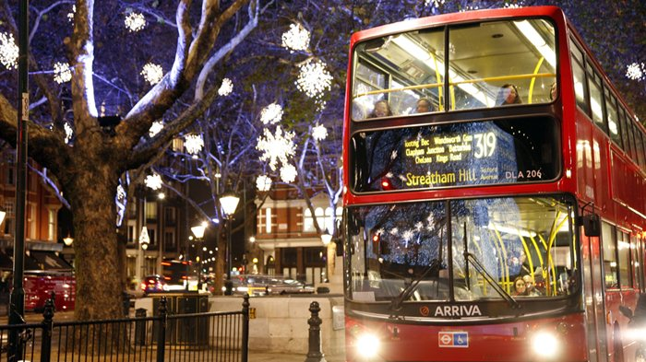
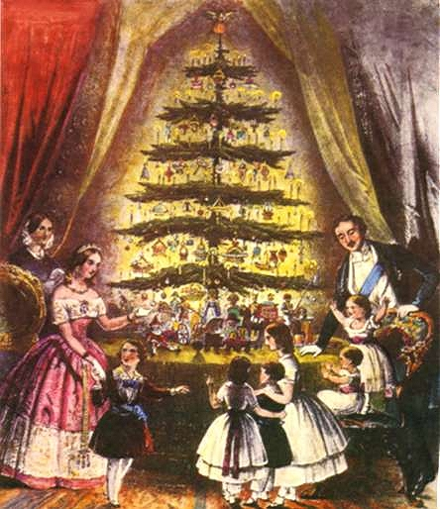
Many of Christmas customs began long before Jesus was born. They came from earlier festivals which had nothing to do with the Christian church. Long time ago people had mid-winter festivals when the days were shortest and the sunlight weakest. They believed that their ceremonies would give the sun back its power. The Romans, for example, held the festival of Saturnalia around 25 December. They decorated their homes with evergreens to remind them of Saturn, their harvest god, to return the following spring.

Slide 5
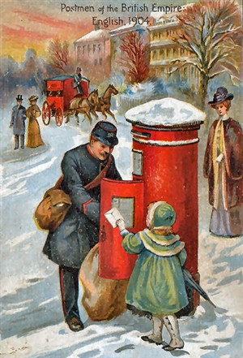
In Victorian times some new ideas such as Father Christmas, Christmas cards and crackers were added to the celebrations.

Slide 6
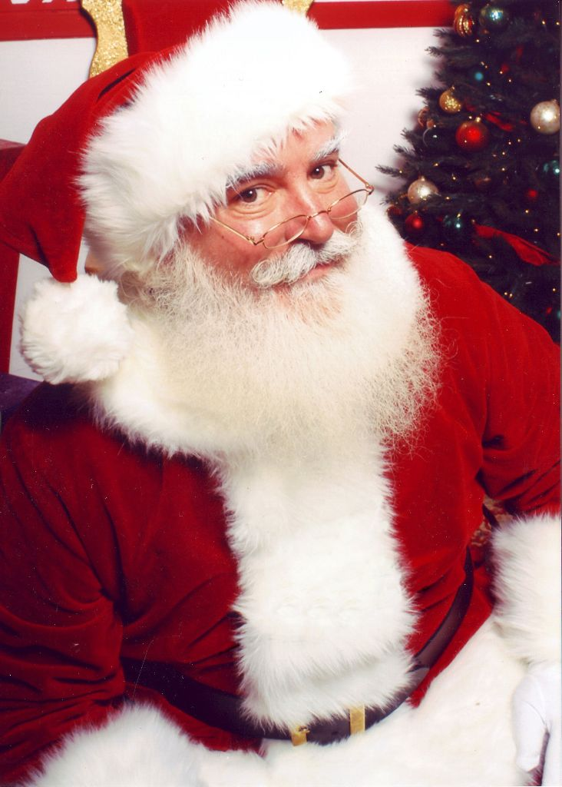
The English gift giver is called Father Christmas. He wears a long red or green robe, and leaves presents in stockings on Christmas Eve. However, the gifts are not usually opened until the following afternoon.
Father Christmas delivers them during the night before Christmas. The Children leave an empty stocking or pillowcase hanging at the end of the bed. In the morning they hope it will be full of presents.

Slide 7
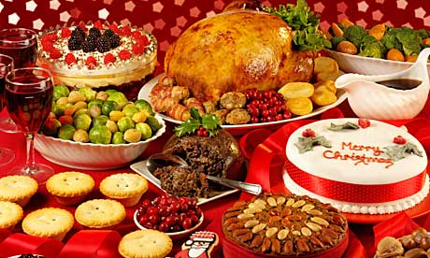
In England the traditional Christmas dinner is roast turkey with vegetables and sauces. For dessert it is rich, fruity Christmas pudding with brandy sauce. Mince pies, pastry cases filled with a mixture of chopped dried fruit.

Slide 8
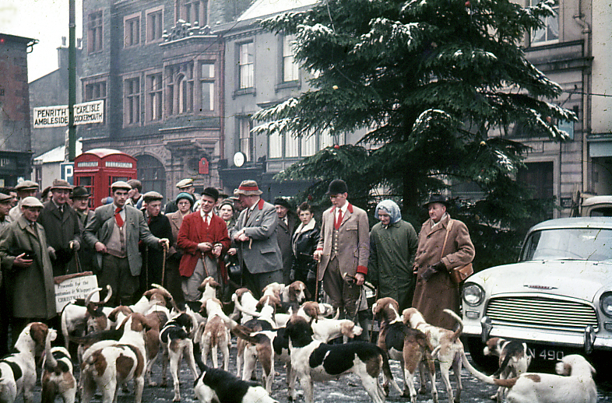
Boxing Day is traditionally the day following Christmas Day, when servants and tradesmen would receive gifts, known as a "Christmas box", from their bosses or employers
Today, Boxing Day is the bank holiday that generally takes place on 26 December. It is observed in the United Kingdom, Canada, Hong Kong, Australia, New Zealand, Kenya, South Africa, Guyana, Trinidad and Tobago and other Commonwealth nations.

Slide 9
Thank you

