Slide 1
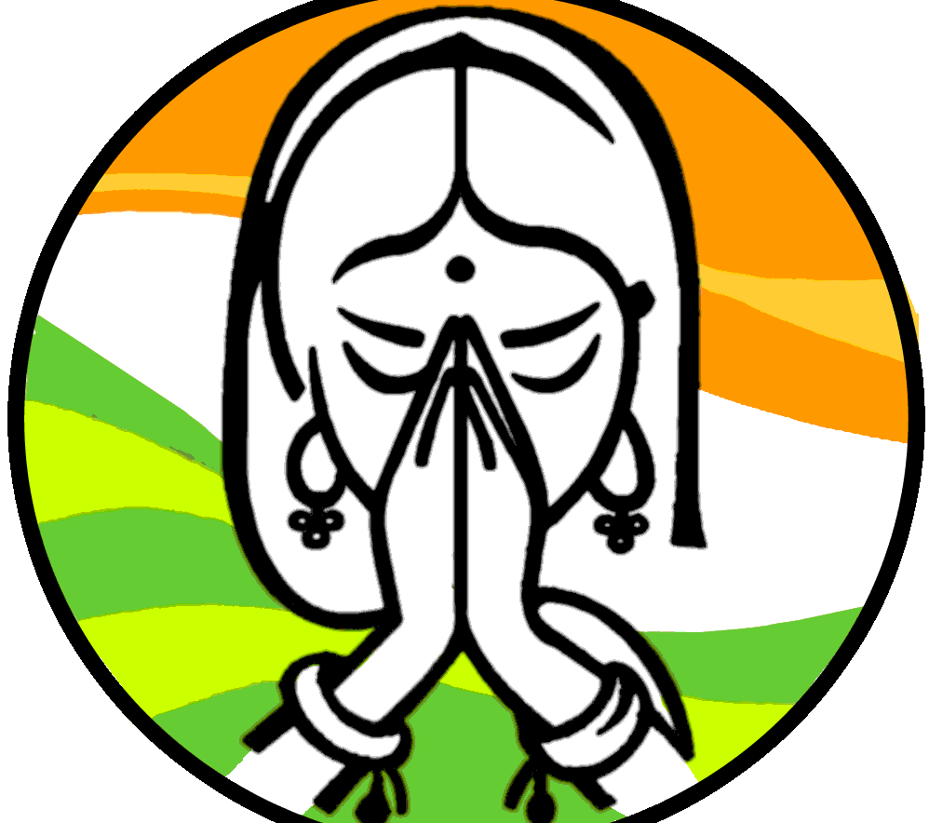

Slide 2

Indian Business Ethics and Culture
India is one of the most diverse countries in the world and therefore all generalisations about Indian culture should be treated with caution. Try to research each client thoroughly before entering into any negotiations. Is it a traditional, family-run business or a more modern hi-tech operation working with western business methodology

Slide 3
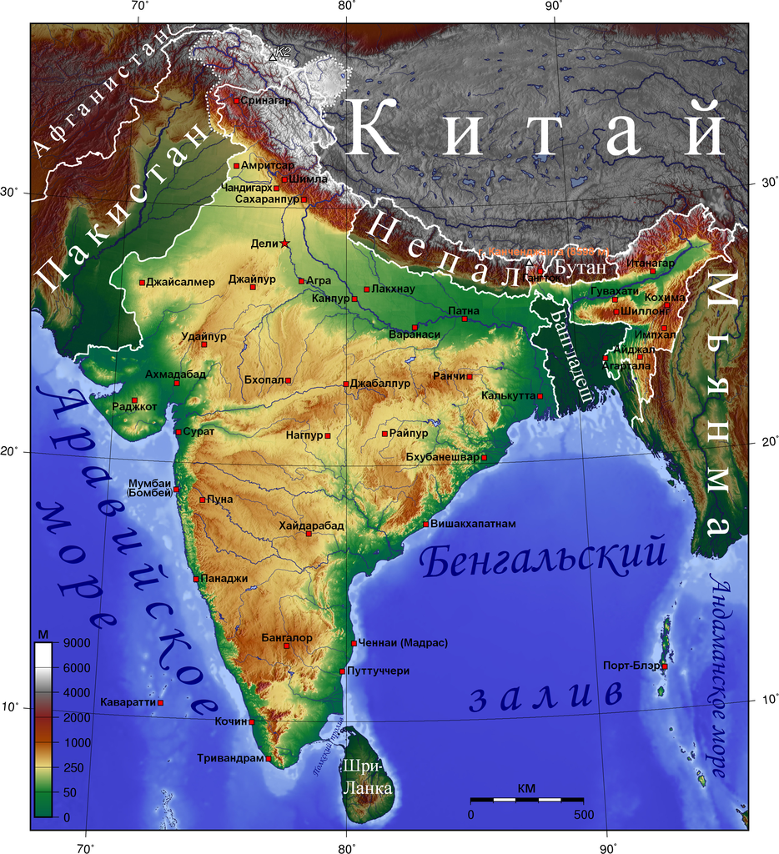

Slide 4
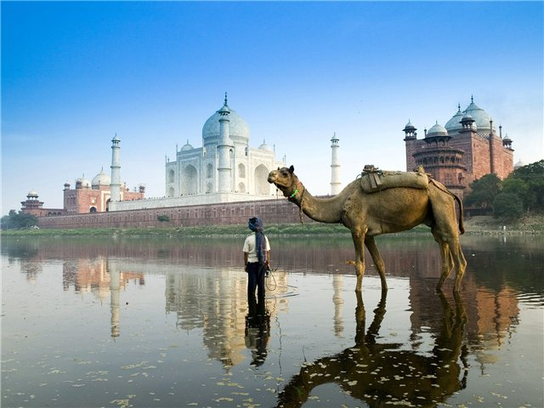

Slide 5
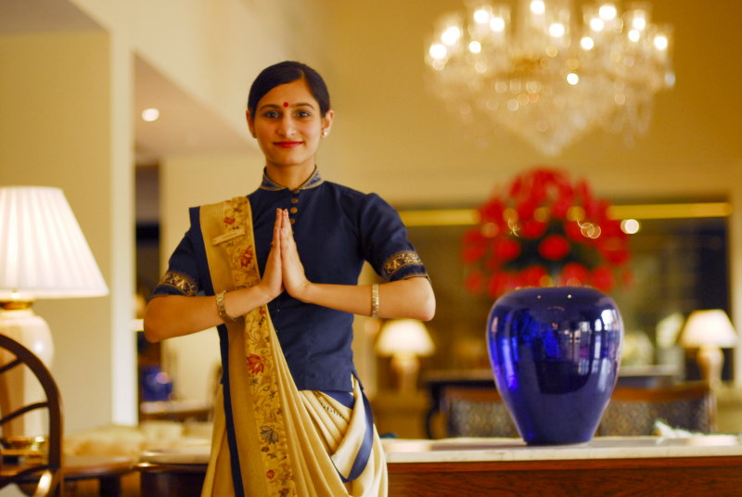
Meeting and Greeting
Westerners may shake hands, however, greeting with 'namaste' (na-mas-TAY) (placing both hands together with a slight bow) is appreciated and shows respect for Indian customs.

Slide 6
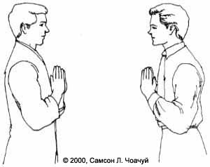

Slide 7
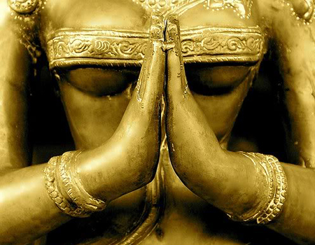
Men shake hands with men when meeting or leaving. Men do not touch women when meeting or greeting. Western women may offer their hand to a westernized Indian man, but not normally to others.
Traditional Indian women may shake hands with foreign women but not usually with men.

Slide 8


Slide 9
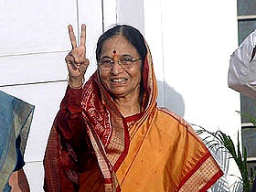
Body Language
Indians generally allow an arm's length space between themselves and others. Don't stand close to Indians. Indians value personal space.
Indian men may engage in friendly back patting merely as a sign of friendship.
Do not touch anyone's head. The head is considered sensitive
Never point with a single finger or two fingers (used only with inferiors). Point with your chin, whole hand or thumb. The chin is not used to point at superiors.

Slide 10
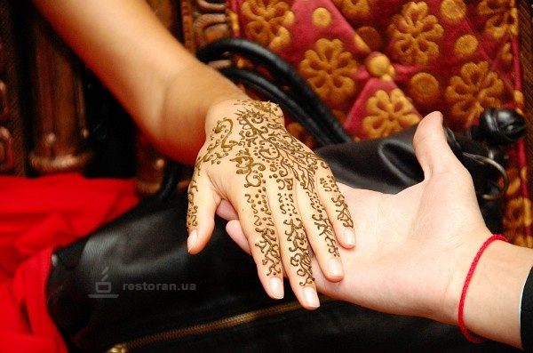

Slide 11
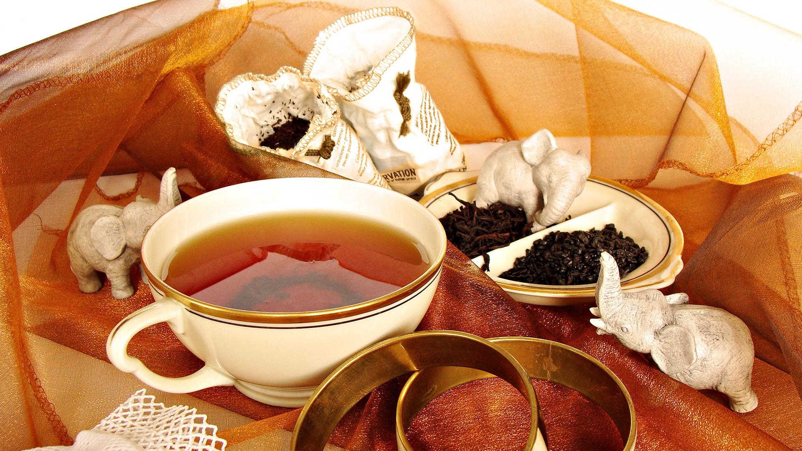
Corporate Culture
It is considered rude to plunge into business discussions immediately. Ask about your counterpart’s family, interests, hobbies, etc. before beginning business discussions.
You may be offered a sugary, milky tea, coffee or a soft drink. Don’t refuse. Note that your glass or cup may be refilled as soon as it is emptied.
Indian counterparts may not show up for scheduled meetings. Be prepared to reschedule.

Slide 12
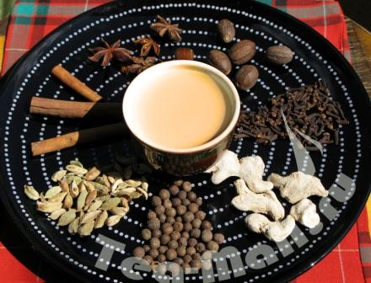

Slide 13
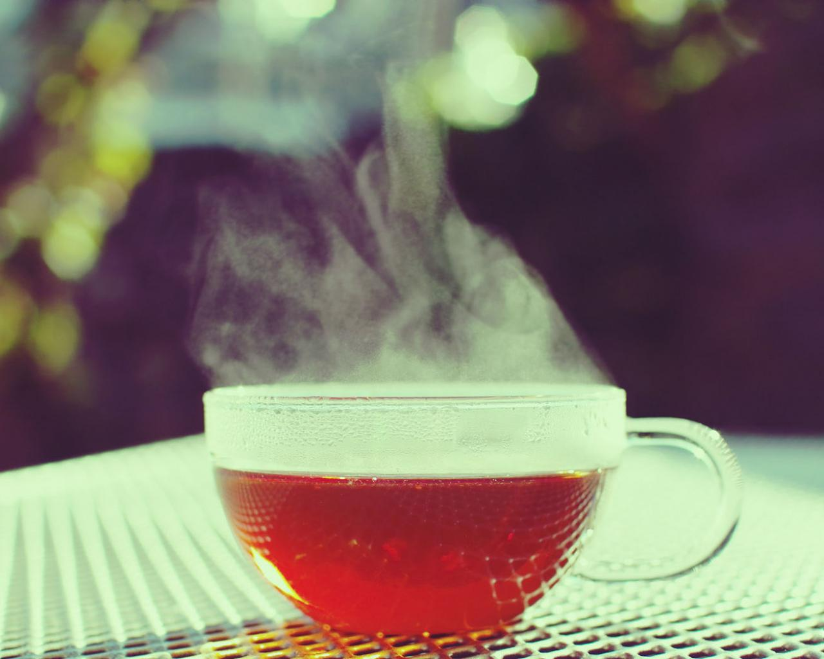

Slide 14
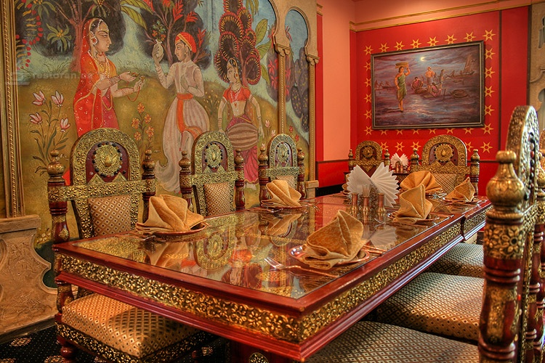
Dining and Entertainment
Initial business entertainment is done in restaurants in prestigious hotels. Business can be discussed during meals. Allow your host to initiate business conversation.
Never flatly refuse an invitation to a home or dinner of a business counterpart; if you can’t make it, offer a plausible excuse.
Allow hosts to serve you. Never refuse food, but don’t feel obligated to empty your plate. Hindu hosts are never supposed to let their guests’ plates be empty.
Take food from communal dish with a spoon; never your fingers. Use chappati or poori (bread) torn into small chunks to scoop up food.

Slide 15
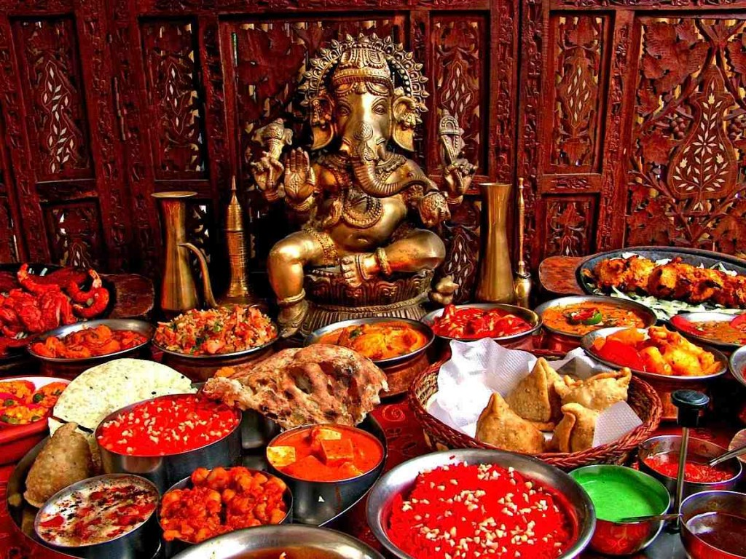

Slide 16
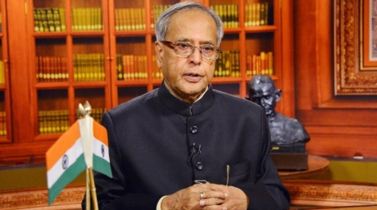
Dress
For business, men should wear suits and ties. During summer months, you may omit the jacket.
Women should wear conservative pantsuits or dresses

Slide 17
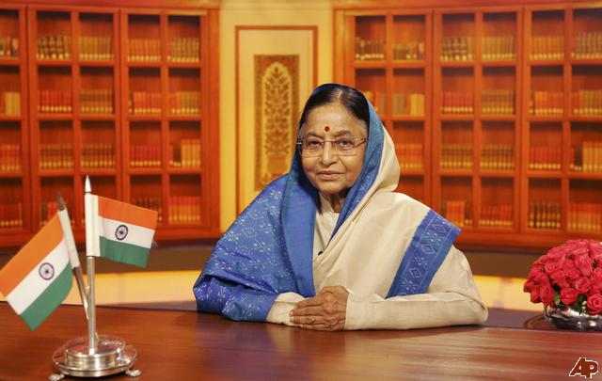

Slide 18
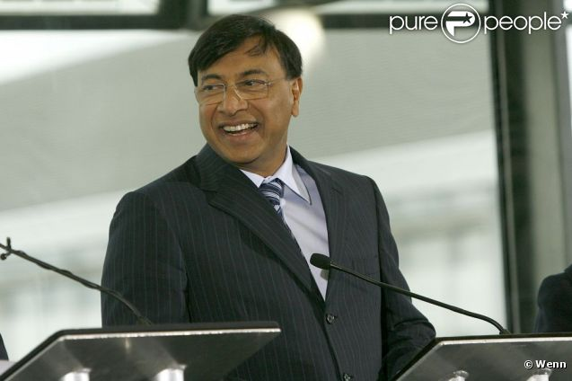

Slide 19

Gifts
Give gifts with both hands. Gifts are not normally opened in the presence of the giver.
Gifts from your country are appreciated (perfume, chocolates, small china or crystal objects).
Gifts are not normally expected at the first meeting. Gifts may be given once a relationship develops.

Slide 20


Slide 21
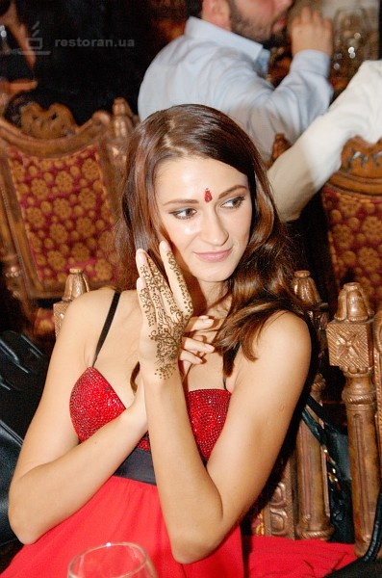
Especially for Women
India is a difficult place to do business, but particularly tough for women. India is a male-dominated society. Western women may be accepted, but must establish their position and title immediately to warrant acceptance.
Women might not be included in social events or conversation.
Western women may invite an Indian man to a business lunch and pay the tab without embarrassment.

Slide 22
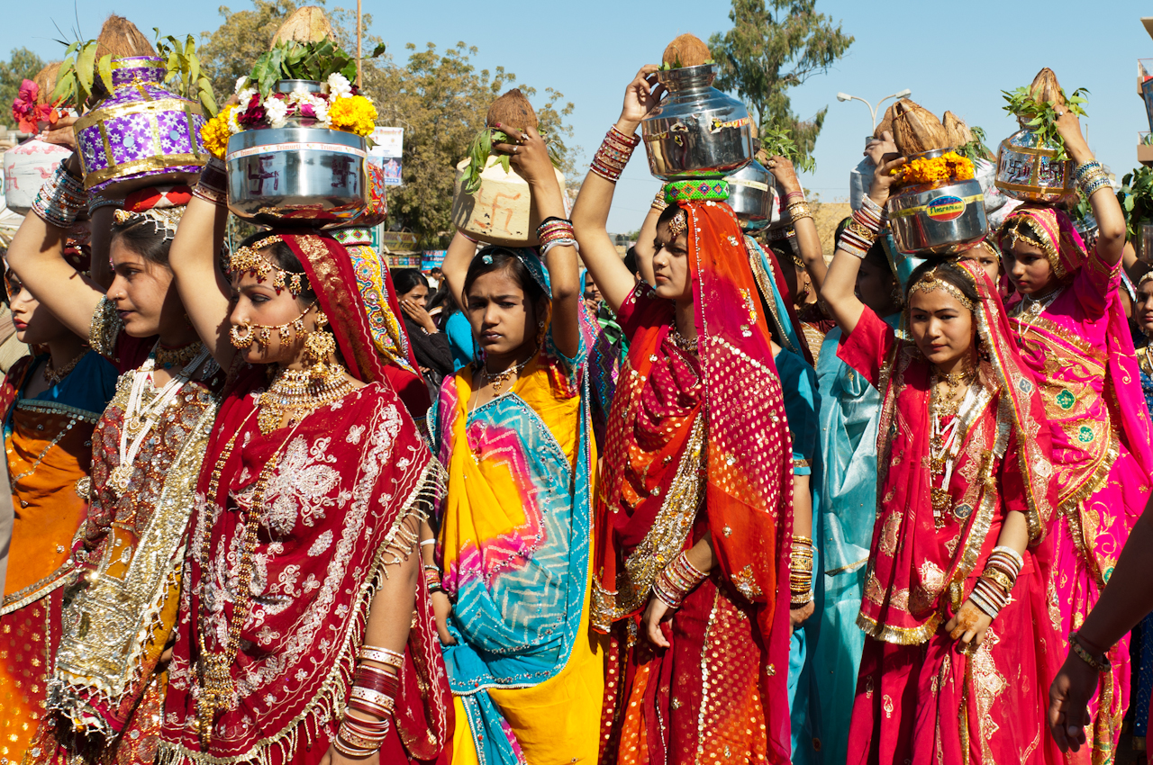

Slide 23
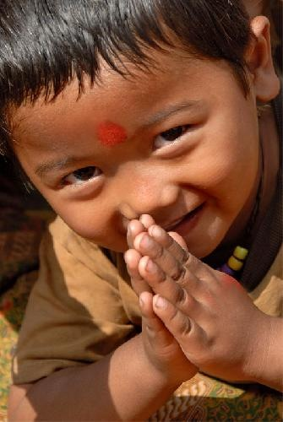
THANK YOU FOR WATCHING!!!

