Slide 1

The United States of America
Olga Novik
10-B form

Slide 2
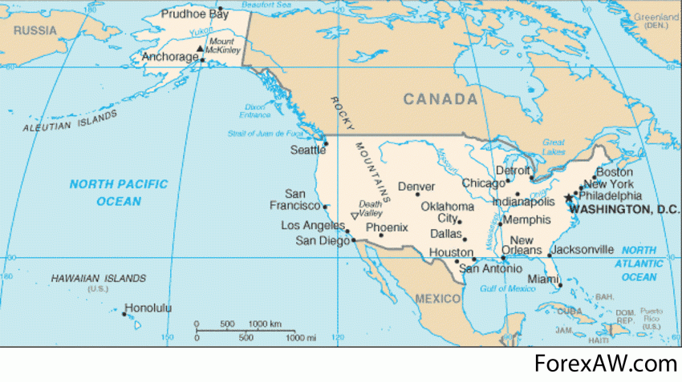
The United States of America lie in the middle of the North American continent. The area of the USA is over nine million square kilometres. It’s population is more than 260 million people. In the north the USA is bordered by Canada, and in the south it borders on Mexico.It is washed by the Atlantic Ocean in the East and by the Pacific Ocean in the West.

Slide 3
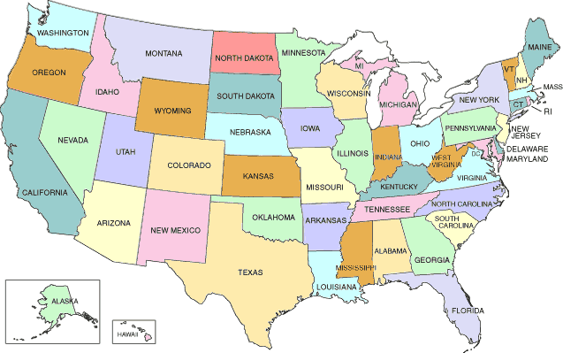
The country is composed of 50 states today. The country is rich in coal, oil, iron, and minerals. The United States economy is highly developed. The United States is one of the leading countries in the world economy. The people of the United States are a mixture of many different nationalities.

Slide 4

The land area of the contiguous United States is 2,959,064 square miles

Slide 5
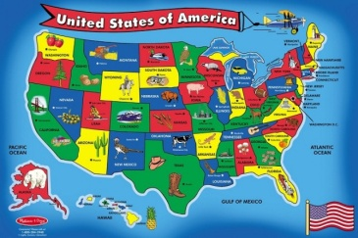
The USA is washed by the Pacific, the Atlantic Ocean, by the Caribbean Sea and The Gulf of Mexico

Slide 6
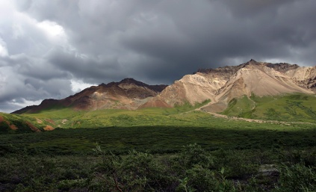
The United States, with its large size and geographic variety, includes most climate types.

Slide 7
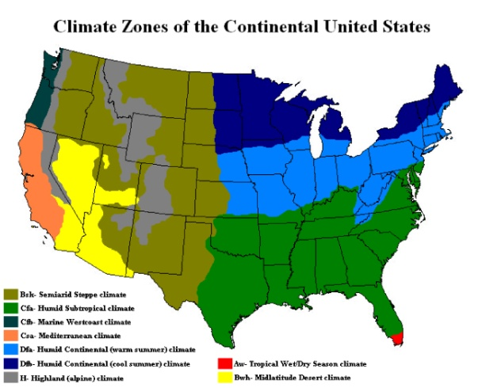
To the east the climate ranges from humid continental in the north to humid subtropical in the south. The southern tip of Florida is tropical, as is Hawaii. The Great Plains west of the 100th meridian are semi-arid. Much of the Western mountains are alpine. The climate is arid in the Great Basin, desert in the Southwest, Mediterranean in coastal California, and oceanic in coastal Oregon and Washington and southern Alaska. Most of Alaska is subarctic or polar.

Slide 8
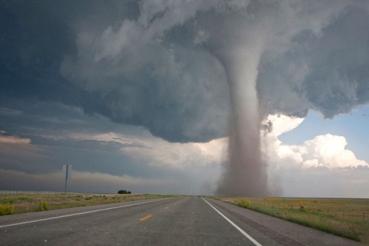
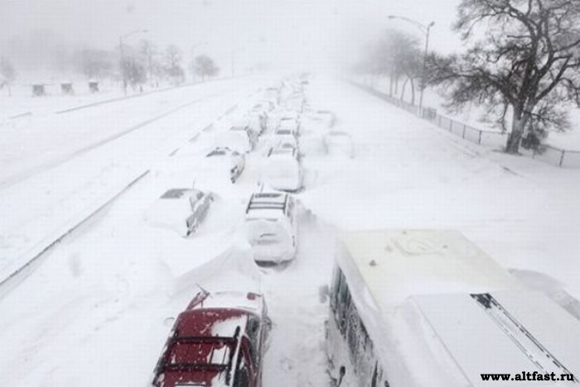
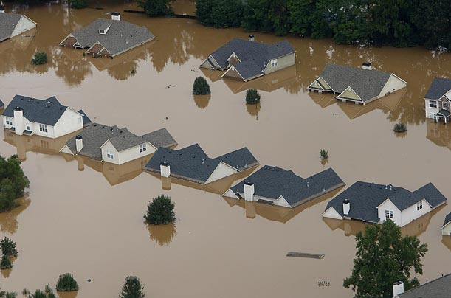
Extreme weather is not uncommon—the states bordering the Gulf of Mexico are prone to hurricanes, and most of the world's tornadoes occur within the country, mainly in the Midwest's Tornado Alley.

Slide 9
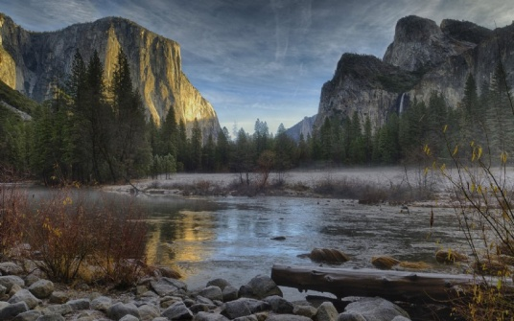
There are 58 national parks and hundreds of other federally managed parks, forests, and wilderness areas. Most of this is protected, though some is leased for oil and gas drilling, mining, logging, or cattle ranching.

Slide 10
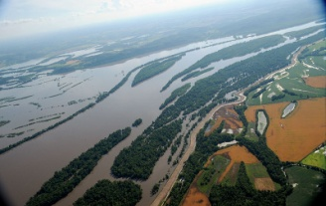
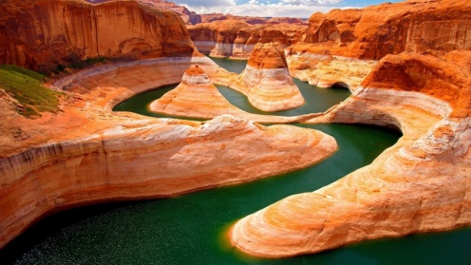
Rivers
Mississipi begins in the north and ends in the gulf of Mexico.
The Colorado river rises in the Rocky Mountains.

Slide 11
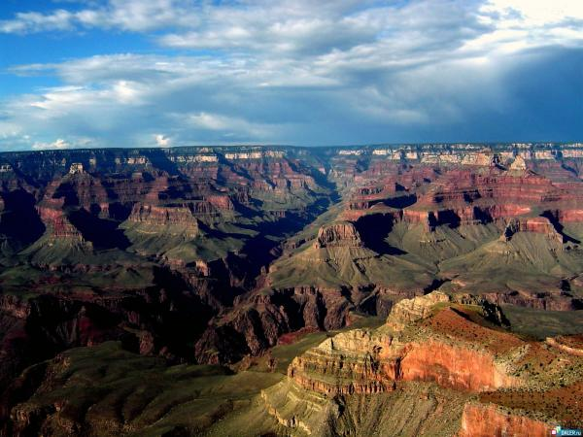
The Rocky Mountains stretch from Alaska down almost to the south of the country.

Slide 12
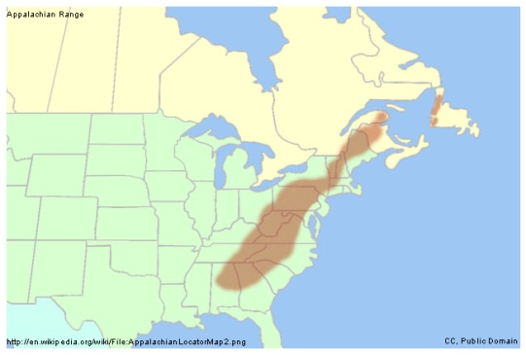
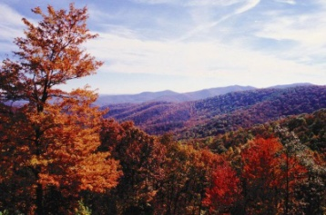
The Appalachians are in the east and run from north to south.

Slide 13
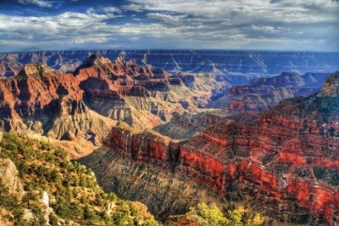
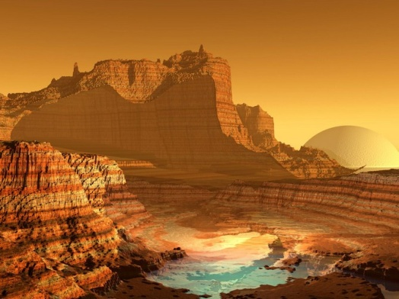
The Grand Canyon
The Colorado River formed the Grand Canyon over millions of years.

Slide 14
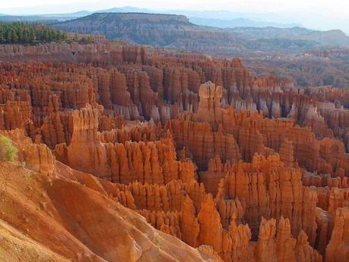
The canyon is one mile deep and 200 miles long.

