Slide 1
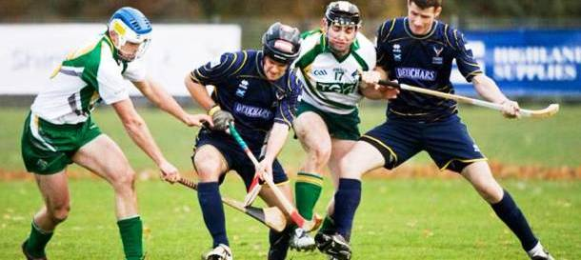
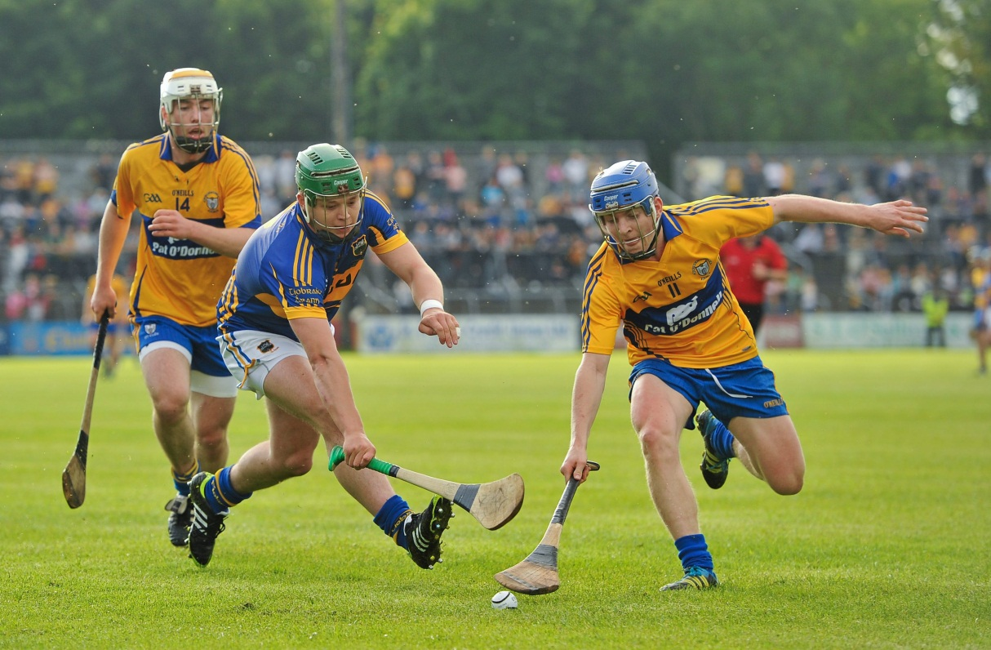
Hurling
The unusual mix of soccer, baseball and hockey

Slide 2
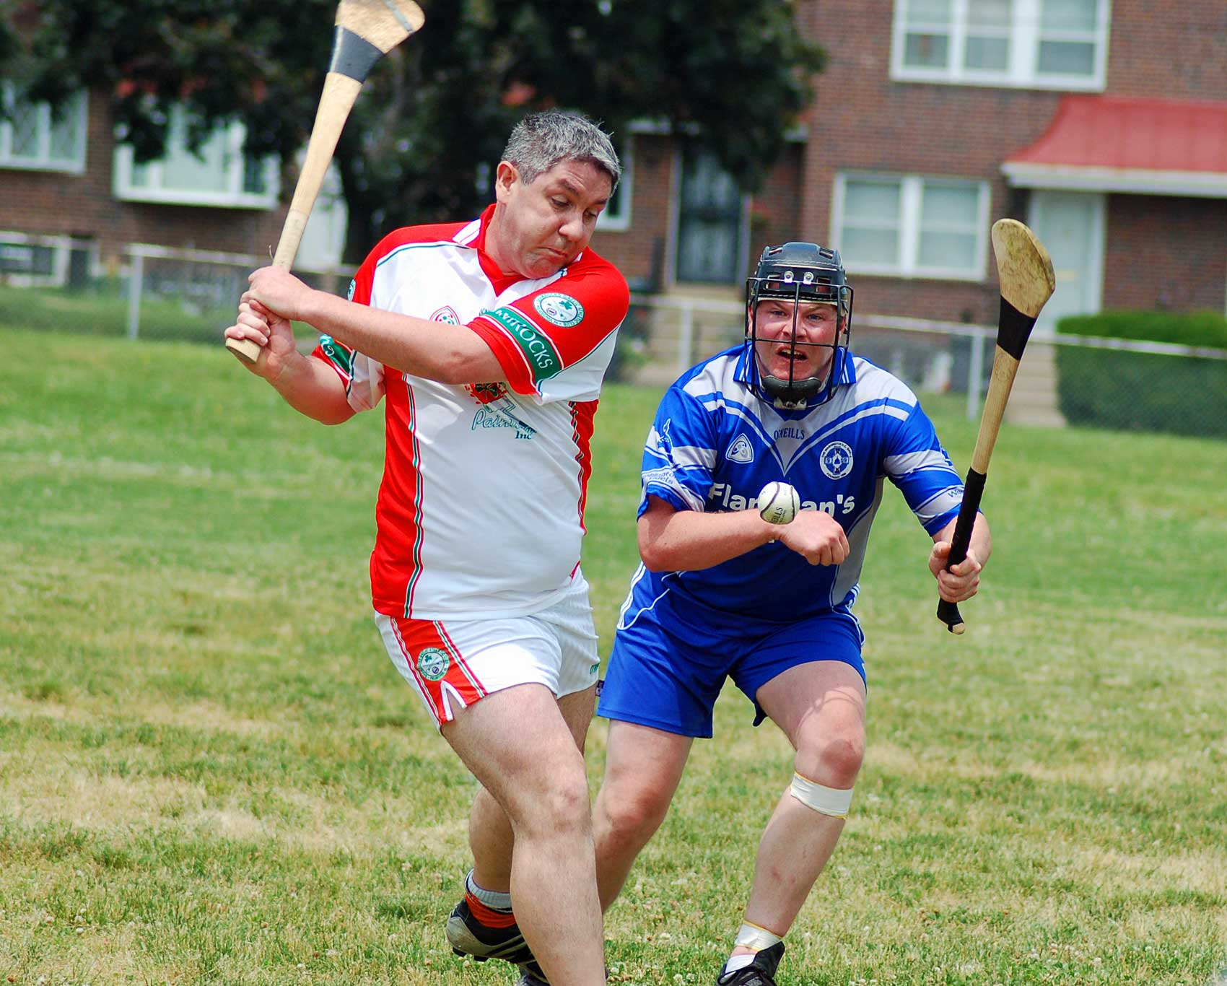
Hurling is an outdoor team game of ancient Gaelic and Irish origin, administered by the Gaelic Athletic Association (GAA). The game has prehistoric origins, has been played for over 3,000 years, and is considered to be the world's fastest gameplay sport.

Slide 3
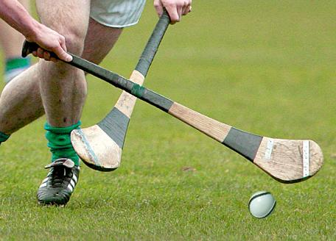
The objective of the game is for players to use a wooden stick called a hurley to hit a small ball called a sliotar between the opponents' goalposts either over the crossbar for one point, or under the crossbar into a net guarded by a goalkeeper for one goal, which is equivalent to three points. The sliotar can be caught in the hand and carried for not more than four steps, struck in the air, or struck on the ground with the hurley.

Slide 4
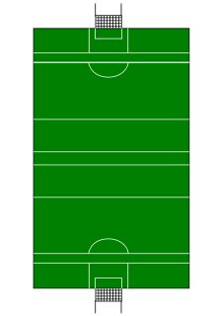
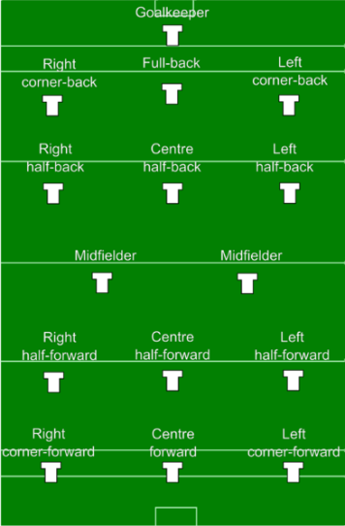
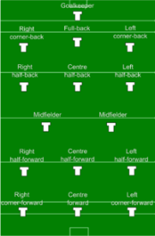
Teams consist of fifteen players and they line out as below. The panel is made up of 24–30 players and five substitutions are allowed per game. An exception can now be made in the case of a blood substitute being necessary.

Slide 5
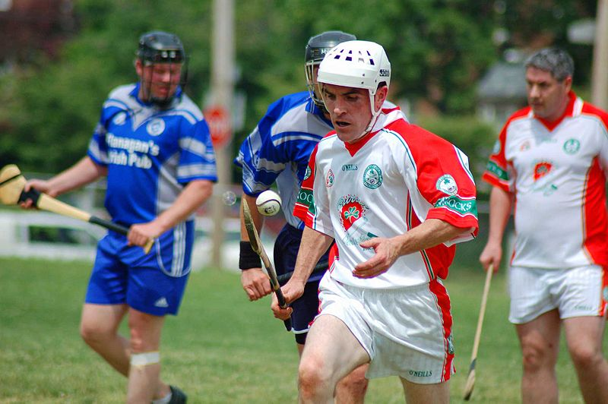
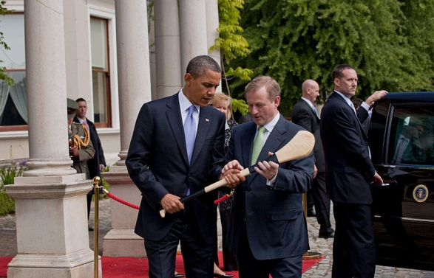
Hurling is played throughout the world, and is popular among members of the Irish diaspora in North America, Europe, Australia, New Zealand, South Africa and Argentina. There is no professional league, so the players today are unpaid amateurs. In many parts of Ireland, it is a fixture of life. It has featured regularly in art forms such as film and literature. The final of the All-Ireland Senior Hurling Championship was listed in second place by CNN in its "10 sporting events you have to see live", after the Olympic Games and ahead of both the FIFA World Cup and UEFA European Football Championship.

