Slide 1
English-speaking countries

Slide 2
English-speaking countries
English-speaking countries are: Great Britain, USA, Canada, Australia, New Zealand.

Slide 3
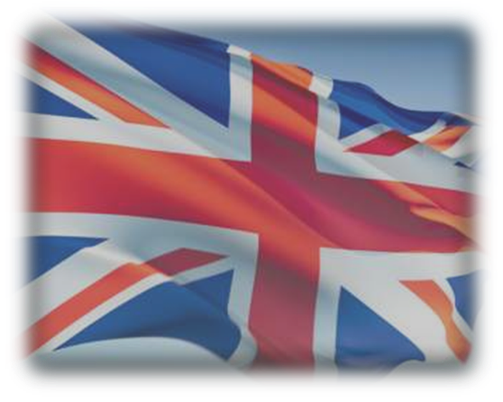
The UK
The United Kingdom of Great Britain and Northern Ireland consists of 4 parts: Wales, Scotland, Northern Ireland and England.

Slide 4
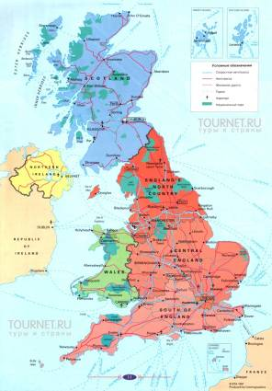
The UK
The British Isles are group of islands which lie out of the northwest coast of the European continent.

Slide 5
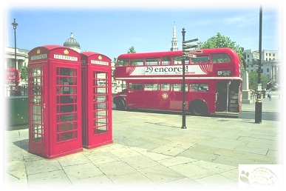
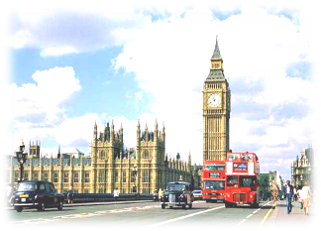
The UK
There are no high mountains, no long rivers, no large forests in the UK. The population of Britain is nearly 56 million people. Britain is a capitalist English-speaking country.

Slide 6
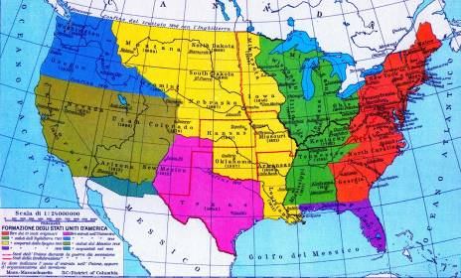
The United States of America
The USA is located in the central part of the North American continent. The population of the USA makes more than 236 million people. The USA is a highly developed industrial English-speaking country.

Slide 7
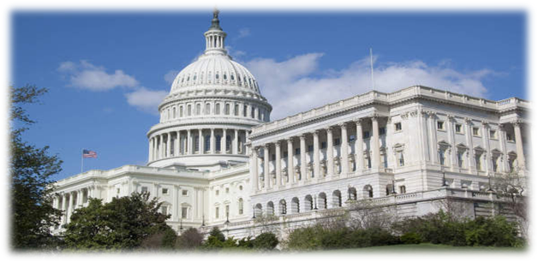
The United States of America
There are two main political parties: the Democratic Party and the Republican Party.

Slide 8
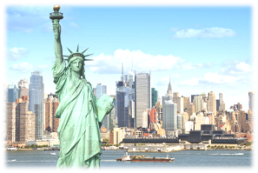
The United States of America
The United States - is a multinational country, so people in the USA speak English and other languages. But English is the state language.

Slide 9
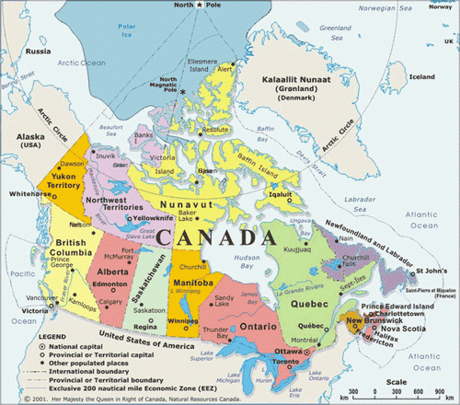
Canada
Canada has an area of ​​about 10 million square kilometers. Its west coast is washed by the Pacific Ocean and the east coast of the Atlantic Ocean.
.

Slide 10
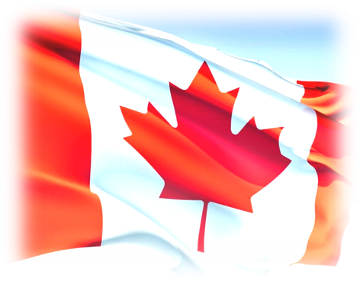
Canada
Canada's population is over 26mln. people. Canada is a member of the Commonwealth.

Slide 11
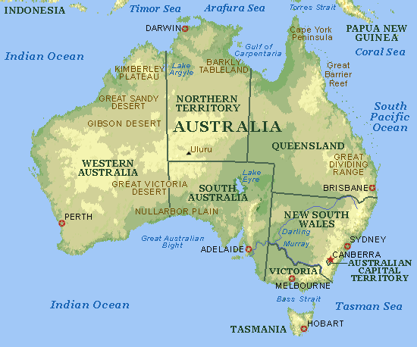
Australia
Australia has the area about 8 million square km. The union of territories of Australia includes: continent of Australia, island of Tasmania and number of small islands.

Slide 12
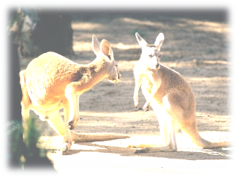
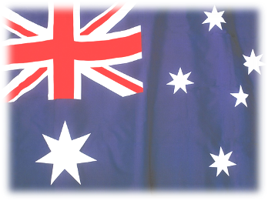
Australia
The population of Australia is more than 16 million people. The Australian Union is a capitalist self-operating federal state.

Slide 13
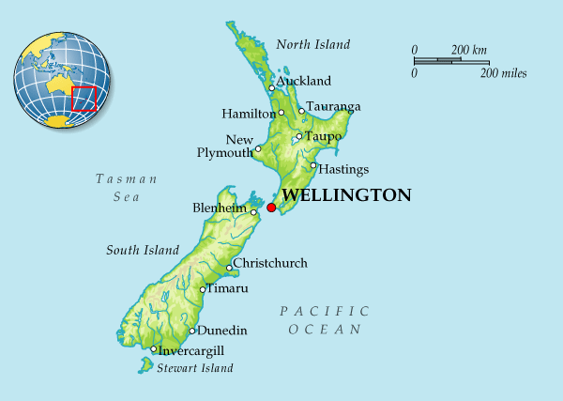
New Zealand
New Zealand is situated to the south-east of Australia. It is located on big islands: North Island, South Island and Stewart Island, as well as many small islands.

Slide 14
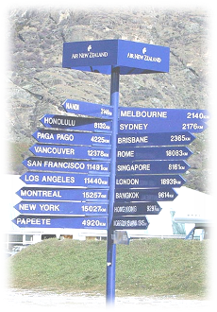
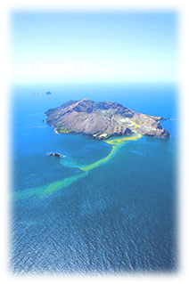
New Zealand
The population of New Zealand is more than three million people. New Zealand is a capitalist state and self-governing member of the Commonwealth.

