Slide 1
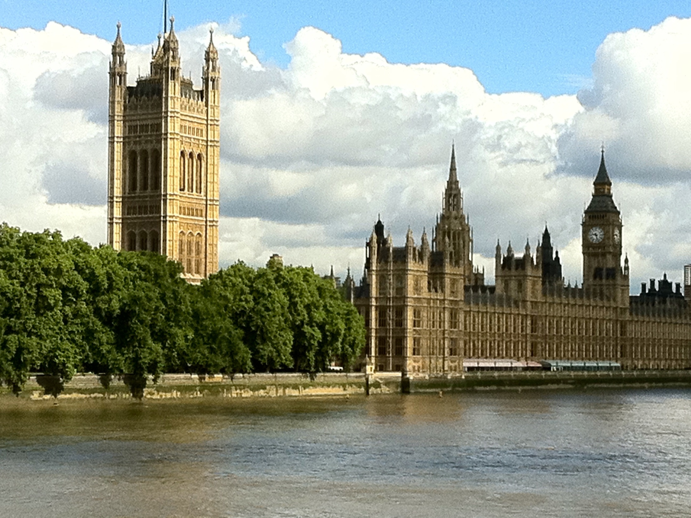
The constitution of the UK

Slide 2
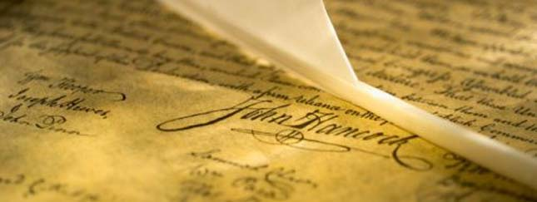
Definition
The constitution of the United Kingdom is the sum of laws and principles that make up the body politic of the United Kingdom.

Slide 3
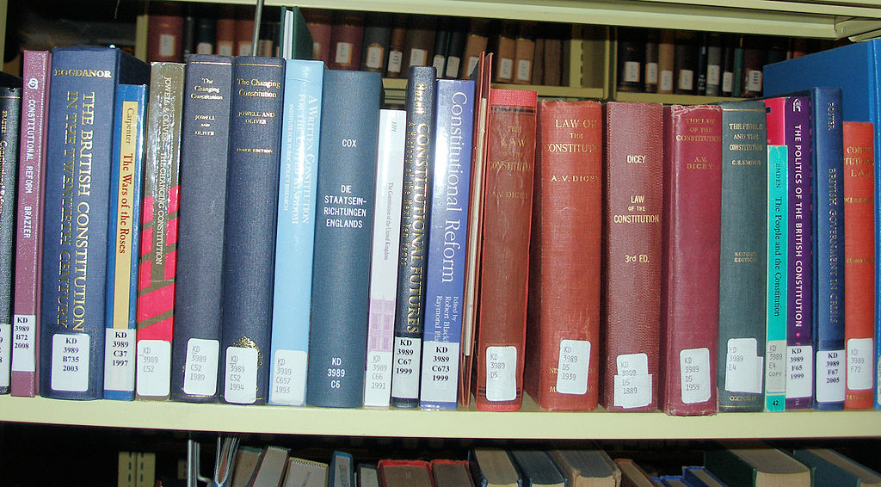
General constitutional principles
Sources
Acts of Parliament are laws (statutes) that have received the approval of Parliament and they are among the most important sources of the constitution.
Treaties automatically become incorporated into UK law.
Common law
Constitutional conventions

Slide 4
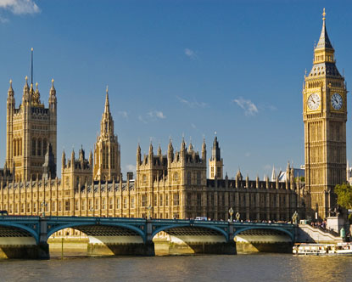
Parliamentary supremacy
Parliamentary sovereignty means that Parliament is the supreme law-making body: its Acts are the highest source of English law.

Slide 5
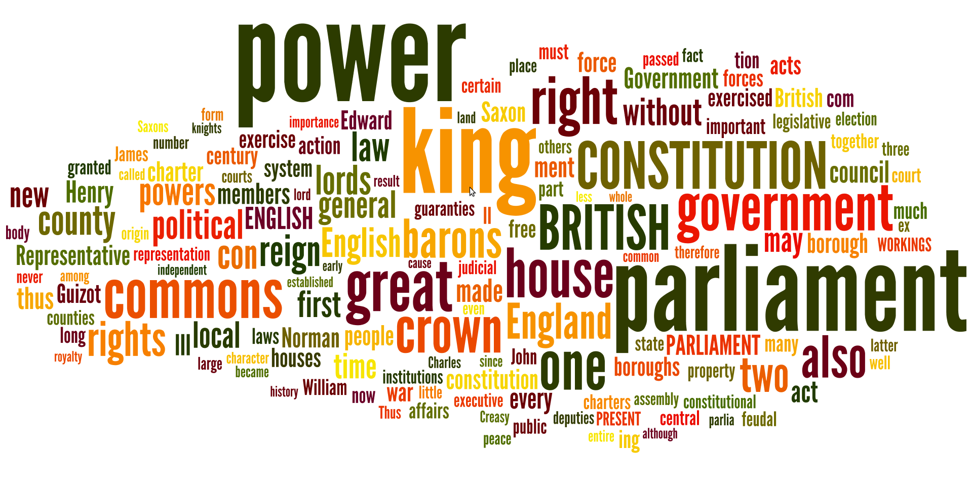
Rule of law
This is the idea that all laws and government actions conform to principles (for example, everyone is equal before the law and no person is above the law, including those in power).

Slide 6
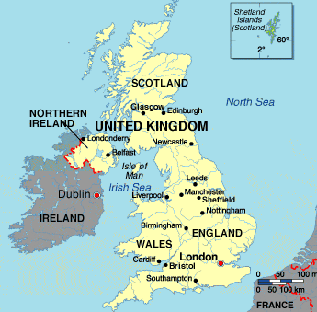
Unity
The United Kingdom comprises four countries: England, Wales, Scotland and Northern Ireland. Nevertheless, it is a unitary state.

Slide 7
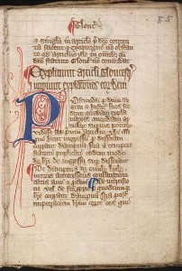
Unlike many other nations, the UK has no single constitutional document.
Much of the British constitution is embodied in written documents, within statutes, court judgments, works of authority and treaties.

Slide 8
Documents in history
Magna Carta (1215)
Acts of Union 1707
Parliament Acts 1911 and 1949
Royal and Parliamentary Titles Act 1927
European Communities Act 1972,
European Union Act 2011
Northern Ireland Constitution Act 1973
Human Rights Act 1998
Constitutional Reform and Governance Act 2010, Succession to the Crown Act 2013

Slide 9
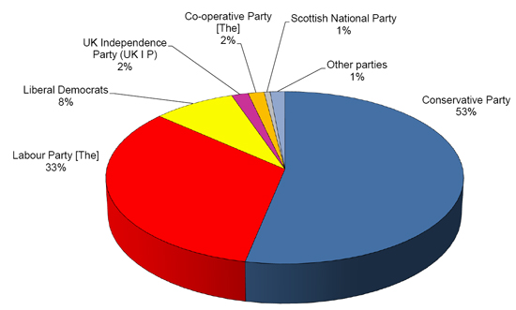
Political parties
There are two main parties in the United Kingdom: the Conservative Party, and the Labour Party. The Liberal Democrats and the Scottish National Party are the third largest political parties.

Slide 10
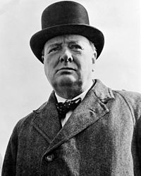
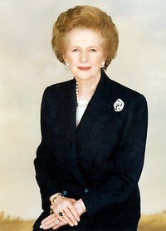
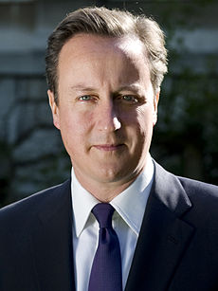
The Conservative Party
The party commonly known as “The Tory Party“
or “the Tories“
It is the traditional right-wing party in the UK
Notable figures include
Winston Churchill, Margaret Thatcher and David Cameron

Slide 11
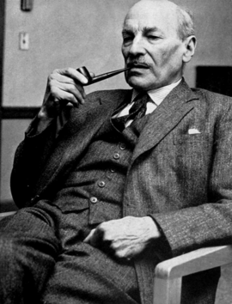
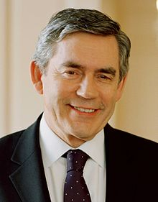
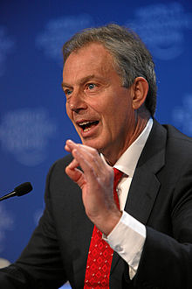
The Labour Party
Founded as a socialist party, this party had a huge role in the creation of the Welfare State and the National Health Service
The red flag, originally the official flag and symbol of the Labour party
Notable figures include Clement Attlee,
Tony Blair and Gordon Brown

