Slide 1
'Pygmalion' by George Bernard Shaw

Slide 3
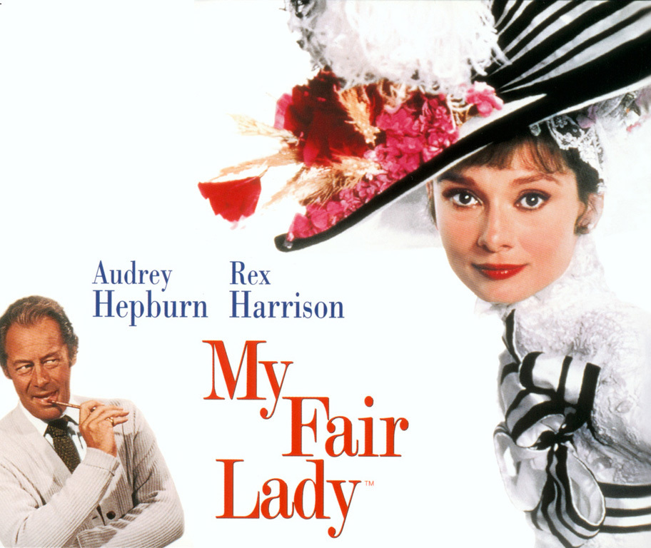

Slide 4
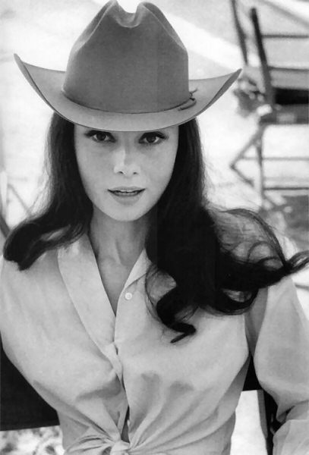
Audrey Hepburn

Slide 5
Elisa Doolitle
Eighteen
Cockney accent
Lowest social level
flower girl

Slide 6
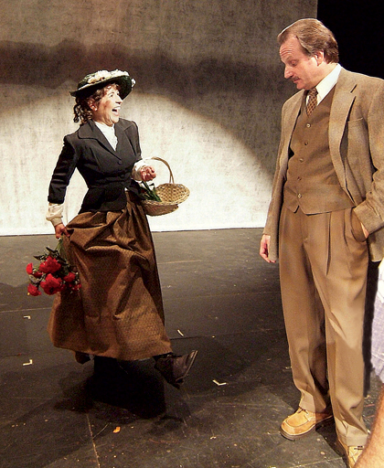
Professor of phonetics Henry Higgins

Slide 8
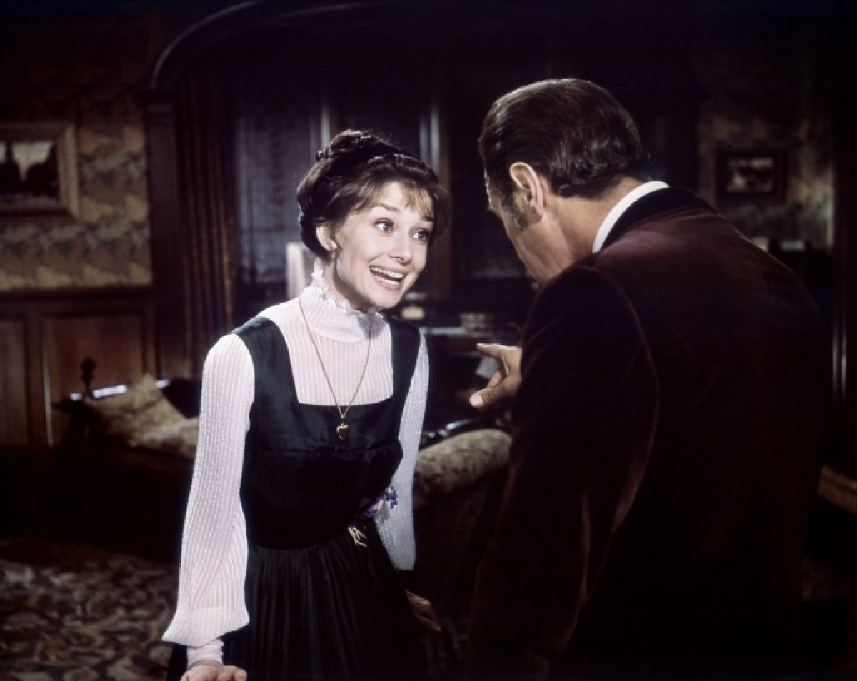
Working hard at pronunciation

Slide 9
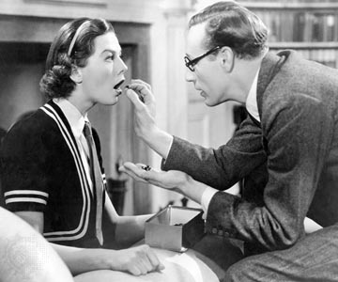
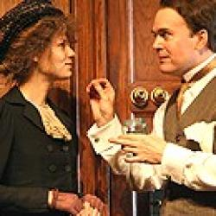
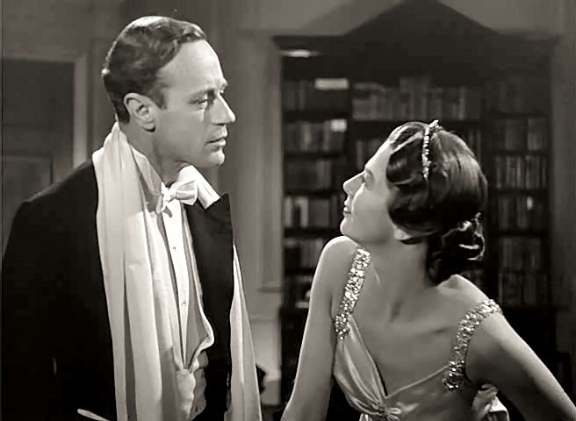
Working, working, working

Slide 10
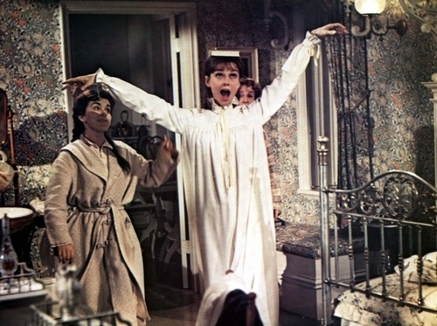
Working at her manners.

Slide 11
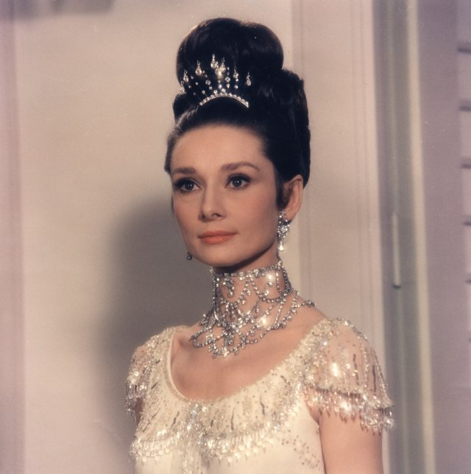

Slide 12
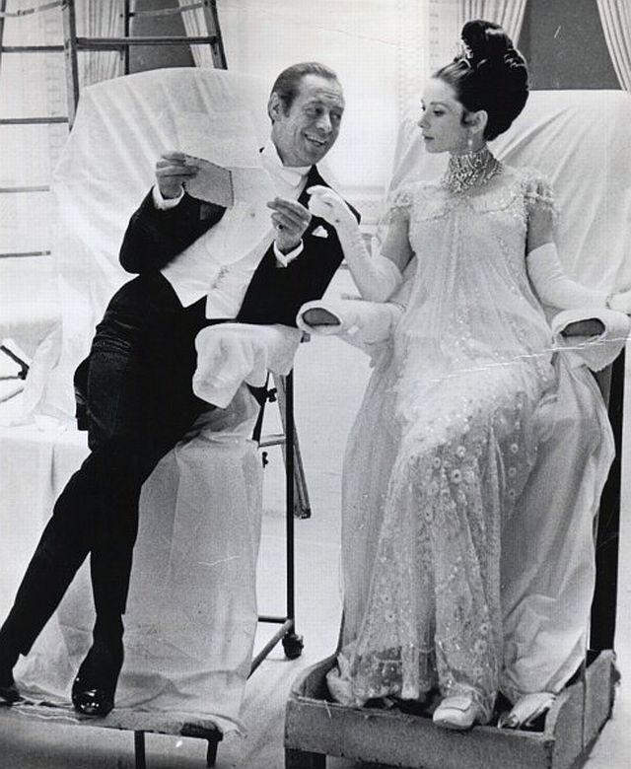

Slide 13
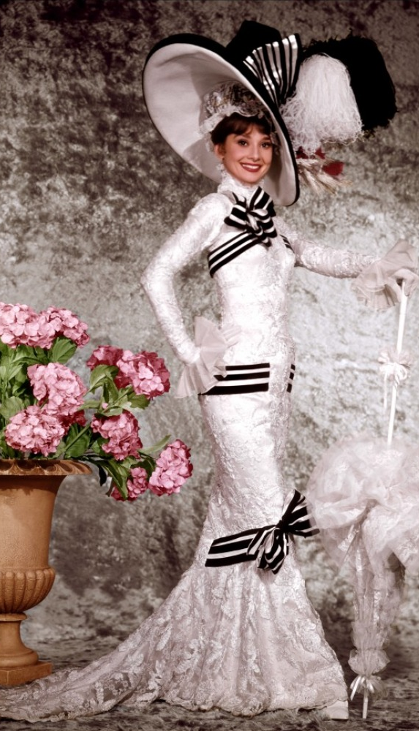
Before
After

Slide 14
The way from flower girl to a real lady

Slide 15
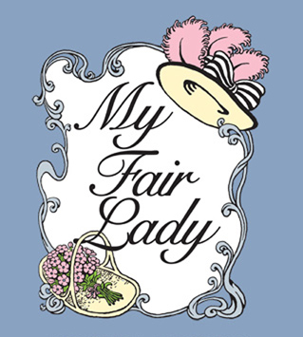
Thank you for watching

