Slide 1
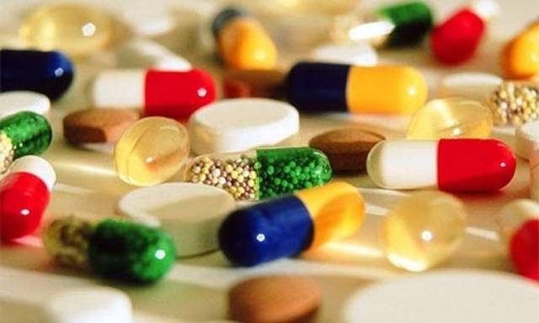
Drugs
You must independently choose way of your life

Slide 2
Unfortunately, there are very many types of drugs. Humanity invented methods of joy by using drugs, but very little numerous of people know about dangerous which cause by them.
People separate drugs on 2 types: light and hard. They are share on opiates, psychostimulants, preparations of cannabis, painkillers.
Это типа как заглавная часть ото шо сверху.
Today we want to tell about the most dangerous drugs such a morphine and crack.
Morphine is one of the types of opiate. This word comes from the Greek God Morphey. Thai drug is in poppy, lunosemyannik and trikliziya. Action of morphine start by 5-10 min after injection. If man employs morphine, he will feel euphoria, sleepines, heat. People accustom to morphine very quickly. As a result, passivity , heart failure, slow breathing are “settle” in yours body.
Crack is one of the types of psychostimulants. It means “stone”. Usually, addicts smoke crack. They mix cocaine with baking soda and water. Crack causes efficiency, rapid pulse, respiration, dilated pupils, lack of appetite etc. But those symptoms are initial. After crack causes nasal bleeding, destruction of the mucous, loss of smell, deafness, psychoses, dying.
Це типа на каждый слайд. Внчале про морфий, а потом про крек.

Slide 3
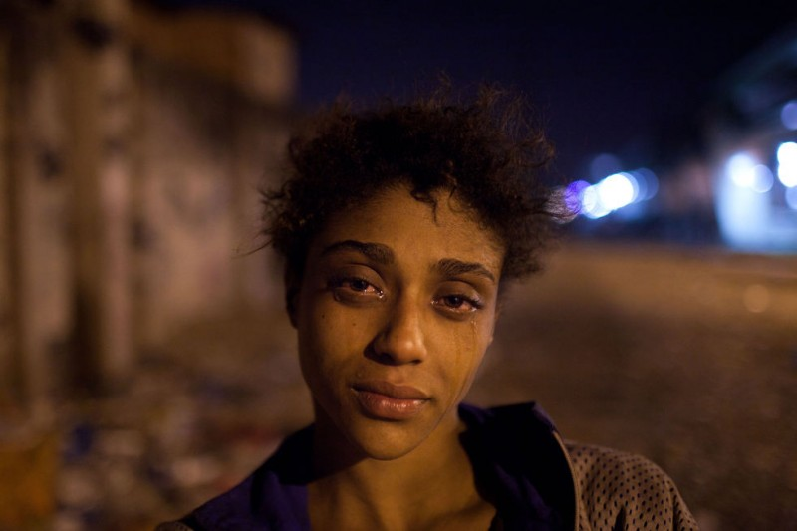
This is Emma. She used crack. Emma died at 23. David and Max are her children. Now they live in mental institution.
Think about your doing!

Slide 4
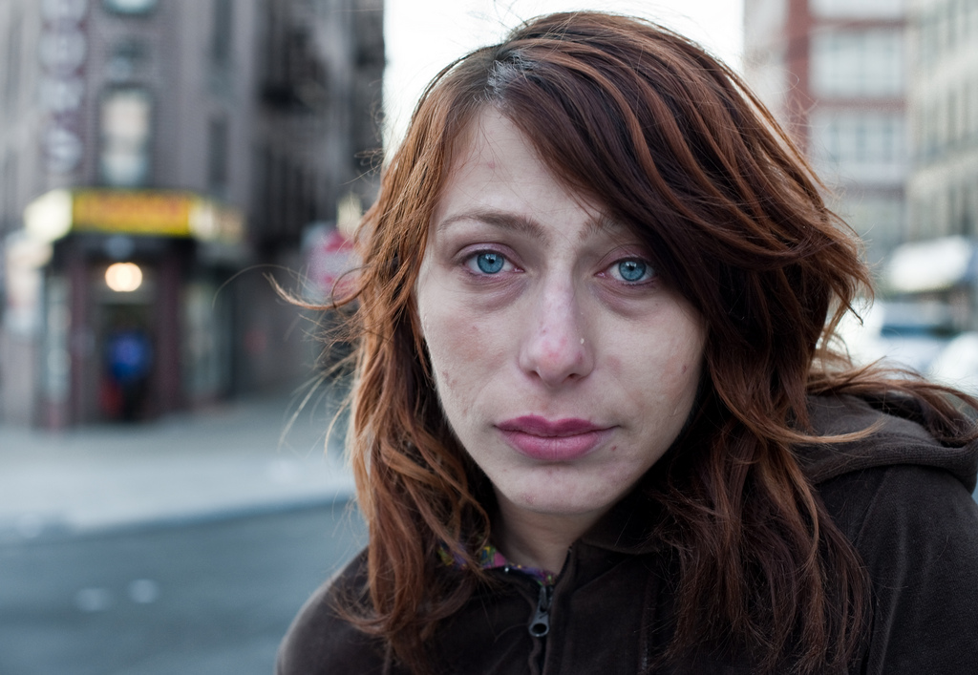
This is Vanessa. She is 35. Women have three children and husband- addict. Vanessa lost heat and started to use heroin. The government took her children, Vanessa became a prostitute. When someone ask Vanessa’s friends about her, they will answer :”Vanessa was the kindest woman that I’ve ever seen”.

Slide 5
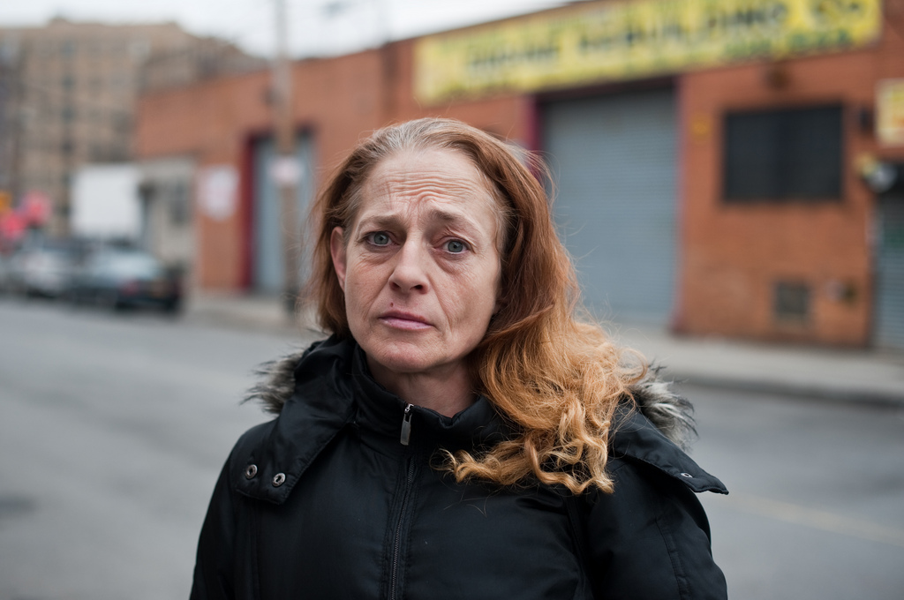
This is Pam. She is 46. In 11 she was raped, in 12 she started to use drugs. Pam is mother of three children. Her husband left her, her father died. Pam started to live on the street.
Now she wanders on Hunts Point street trying earn on heroin. Pam was in the prison where wrote 26 stories for children. Women dreams to publish them.

Slide 6
Mikhail Bulgakov is famous writer, which wrote novel” Master and Margarita”. Maybe, you will have been impressed, when we say that ne was addict. He used morphine. When Bulgakov was a doctor and saved lives, which ill of syphilis, he caught and needed in help. Bulgakov was recovered by morphine. After he can’t refused. Writer used morphine twice on day. He could write after dose. Fortunately, wife was able to help husband. She start to prick ordinary water. In latest years of life Bulgakov started addict again, but in this case wife can’t help him. Mikhail Bulgakov died because of drugs.
Это история человека(в нашем случае Булгакова) ,который умер из-за морфия.

Slide 7
Without fail you know Whitney Houston. She is very famous singer and
actress. She died at 48. Her doom was caused by crack. Unrequited love advised Whitney tasted crack. Women can’t refused. Drugs caused many diseases and Houston foiled many concerts because of dependence and illnesses. In 2012 singer died in hotel on Beverly Hilton. She was found by a maid in bath.
А це типа стори про крек.

Slide 8
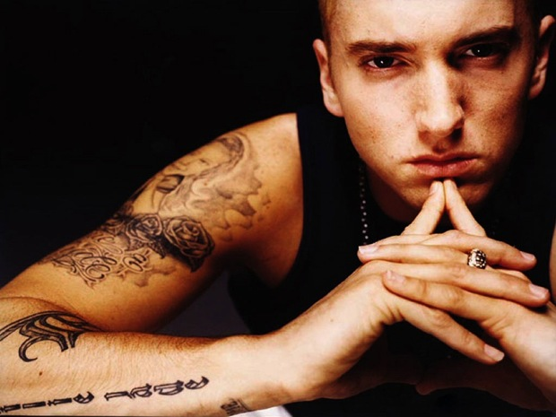
People say that drugs don’t released nobody. This is false. If you really want to win the dependence, you will win it.
This is Eminem(Marshall Mathers ) was an addict. He started to notice what his life became worse. The famous rapper recollected and started to treat. Soon he returned his overpast life. The concerts, fans, autographs.
Remember: you must have huge desire that overcome the dependence!

