Slide 1
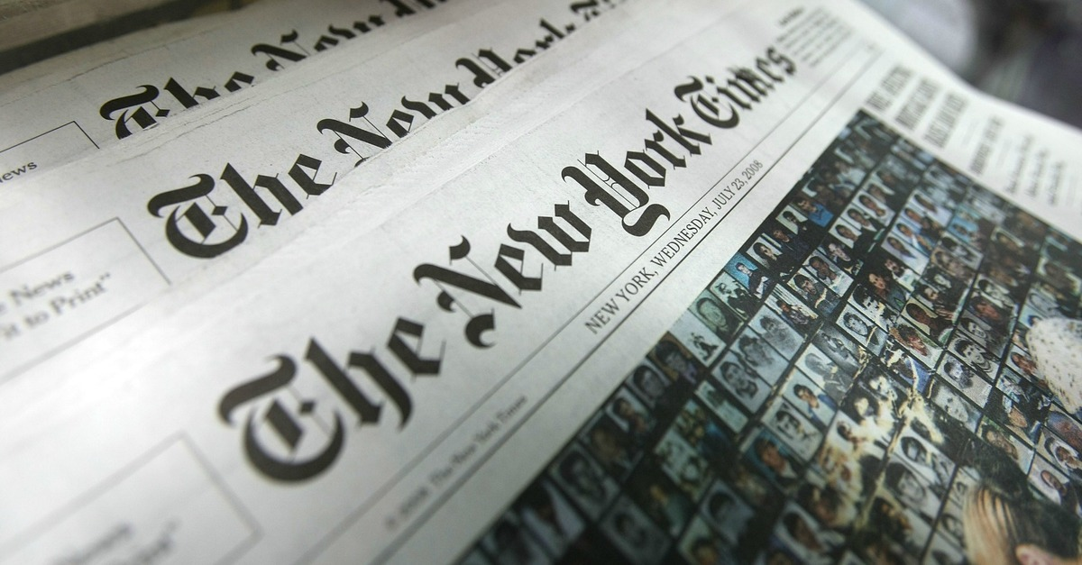
American press

Slide 2

List of newspapers in the United States
List of newspapers in the United States
This list of newspapers in the United States is a list of newspapers printed and distributed in the United States. It includes a list of the 25 newspapers in the United States with the most circulation, followed by lists of newspapers published in United States territory. Those lists are followed by a series of links to other lists of U.S. newspapers, organized by various categories.
As of 31 December 2011, the United States had 1,382 daily newspapers.

Slide 3

The oldest editions
The New Hampshire Gazette (founded in 1756)
Hartford Courant (founded in 1764)
The Augusta Chronicle (founded in 1785)
Daily Hampshire Gazette (founded in 1786)
Pittsburgh Post-Gazette (founded in 1786)
The Berkshire Eagle (founded in 1789)
The Recorder (founded in 1792)
Rutland Herald (founded in 1794)
The Bulletin (founded in 1796)
The Keene Sentinel (founded in 1799)
New York Post (founded in 1801)
The Post and Courier (founded in 1803)
The Post-Standard (founded in 1829)

Slide 4
Most runner
USA Today The Wall Street Journal The New York Times Los Angeles Times Chicago Tribune The Washington Post Daily News New York Post | The Denver Post The Dallas Morning News The Philadelphia Inquirer Houston Chronicle The Detroit News^{[en]} / Detroit Free Press Star Tribune The Star-Ledger^{[en]} | The Boston Globe The Arizona Republic The Atlanta Journal-Constitution^{[en]} Newsday^{[en]} The Plain Dealer^{[en]} San Francisco Chronicle Tampa Bay Times The Seattle Times / Seattle Post-Intelligencer St. Louis Post-Dispatch^{[en]}

Slide 5

Magazines for travelers
The most influential in the world and limited edition publication, focused on the tourism industry, based in the United States and published - is a monthly magazine Conde Nast Traveler and Travel + Leisure.

Slide 6

Thank you!

