Slide 1
My future choice

Slide 2
Every person at the age of 14 to 16 has to make an extremely stressful decision, to choose his or her own career. You might be wondering what the difference is between a career and a job. Basically a job is something you do, but don't expect to continue doing forever. A career is what you hope to do for a long time or even for your entire working life.

Slide 3
Choosing a career is a difficult and challenging task: the decision once taken will influence your future life. There are, of course, a lot of examples when people have changed their career paths in their twenties, thirties and even forties but, of course, it is better to make the right choice at the very beginning. The earlier you decide on what profession is interesting and rewarding for you, the more you can achieve during your lifetime.

Slide 4
Choosing a career is a challenging task indeed. It is all about finding the perfect match between your personality, interests, and skills. On the one hand, modern society, with its hundreds of professions and jobs, presents a vast range of future job opportunities. Industry and business, farming, science and education, medicine, service, arts and journalism are just a few professional fields a young person can specialize in. On the other hand, modern society with its crises, unemployment and inflation, makes a poor choice of profession a really bad mistake. You can choose a profession you really like, and face problems when looking for a job.

Slide 5
Or you can find a job you like, but it will be underpaid. Besides, a young person's parents usually have their own ideas of what career path to choose. Some parents are more democratic and let the child determine his future by himself. Some are oppressive and overprotective and try to force the child to make this or that career choice. In this case, they often try to compensate for their own dreams which have failed and the chances they have missed. Sometimes they see their child is gifted in some field and try to persuade him to choose this profession irrespective of the fact if he likes it or not.

Slide 6
Of course, choosing an occupation is a very difficult question but everybody has to solve it.

Slide 7
I want to be a surgeon

Slide 8
1
Graduate from high school or pass the GED (General Education Development) exam. This is the first step on the road to becoming a surgeon. While in high school, pay special attention to science subjects like biology, physiology, chemistry, and physics. How you perform in these types of classes early on will help you determine whether a career in medicine is the right choice for me.

Slide 9
2
Get a bachelor's degree. While there is no particular major requirement for medical school, you should choose a science-related major and complete coursework in physiology, biology, chemistry, mathematics, and English. Try to space out your pre-med courses over the course of four years so that you can devote enough time to each one and maximize your performance.

Slide 10
3
Take the MCAT (Medical College Admission Test). Your score on this test, as well your college transcripts, will determine whether and where you are accepted to medical school. Once you have completed the test, apply to various medical schools, taking into consideration their reputability, location, and cost. Send your test scores, transcripts, and any additional required materials to the admissions offices of the schools you are applying to.

Slide 11
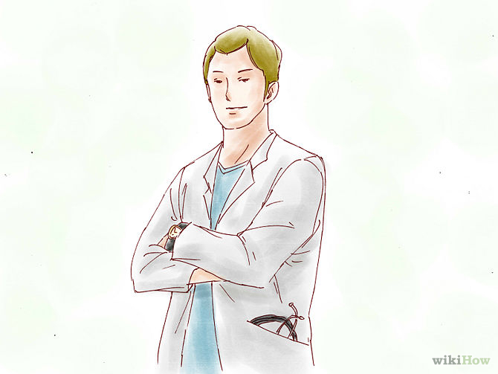
4.Complete medical school. Most programs take four years to complete, and will earn you either a Doctor of Medicine (M.D.) or Doctor of Osteopathic Medicine (D.O.). During the first two years, students study anatomy, biochemistry, psychology, medical ethics, and other subjects in classroom and laboratory settings. During the second two years, students get more hands-on experience treating patients under the supervision of medical professionals.

Slide 12
5
Complete a residency program. Once you have graduated from medical school, you will need to complete a surgical residency program in a specialized area. Residencies vary in duration, lasting from 3 to 8 years, and involve working in hospitals and treating patients under the supervision of other doctors.

Slide 13
6
Get licensed. Every state requires that surgeons and physicians be licensed, but specific requirements vary between states. Eligibility for licensure requires having completed medical school and a residency, and passing written and practical exams

Slide 14
Choose a Field
Decide what type of surgeon you want to be. There are many different types of surgery that a physician can focus on. Your experience during the first two years of medical school will help you narrow down your focus to one specialized area of study. Consider the following examples of different types of surgeons:

Slide 15
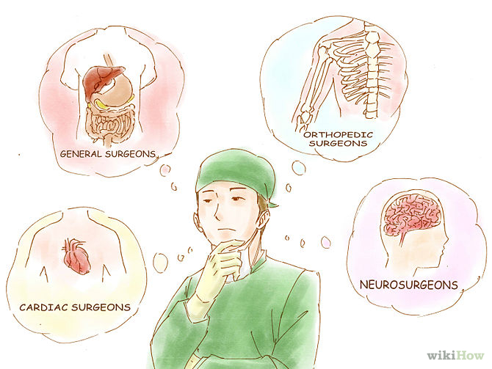
Cardiac surgeons focus on the heart and cardiovascular system, performing surgical treatments for a variety of conditions including atherosclerosis and congenital heart disease.
General surgeons focus on the abdominal area, treating conditions of the appendix, colon, liver, pancreas, gallbladder, and more.
Orthopedic surgeons focus on surgical treatment of musculoskeletal conditions affecting the bones, joints, and ligaments. These include spinal disorders, sports injuries, trauma, and bone tumors.
Neurosurgeons focus on the surgical treatment of neurological conditions.T hey typically complete five to six years of residency training, and perform surgery on the brain, spinal cord, and nerves.

Slide 16
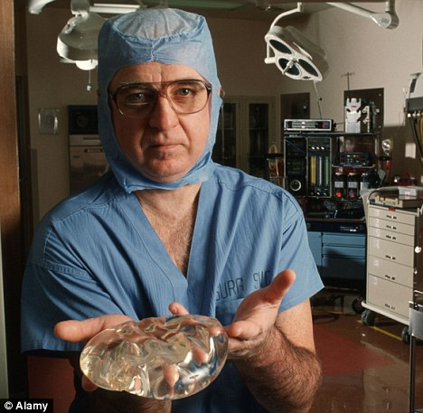
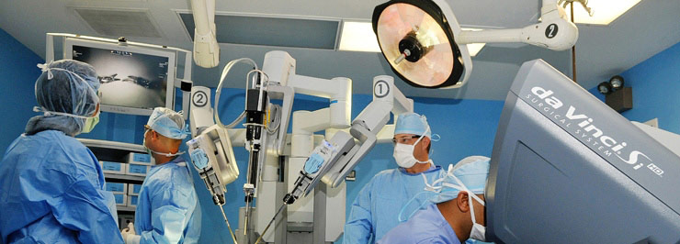
I know that it’s very difficult,but I like it. I want to save lives.It’my dream.Dreams have come true.

