Slide 1
South East England
Culture and interesting places

Slide 2
South East England
South East England is one of nine official regions of England. It consists of Berkshire, Buckinghamshire, East Sussex, Hampshire, the Isle of Wight, Kent, Oxfordshire, Surrey and West Sussex. As with the other regions of England, apart from Greater London, the South East has no elected government.
It is the third largest region of England, with an area of 19,096 km², and is also the most populous with a total population of over eight and a half million (2011).

Slide 3
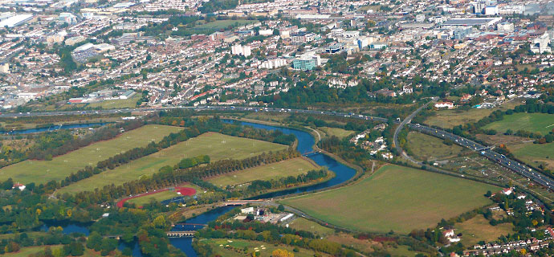
The region is known for its countryside, which includes the North Downs and the Chiltern Hills as well as two national parks: the New Forest and the South Downs. The River Thames flows through the region and its basin is known as the Thames Valley.

Slide 4
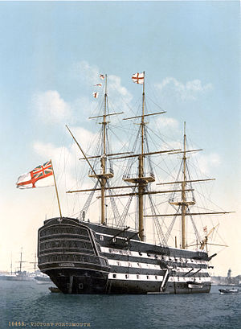
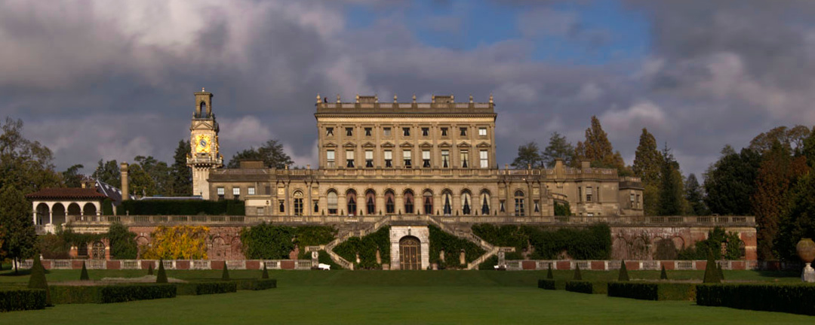
It is also the location for a number of internationally known places of interest, such as HMS Victory in Portsmouth, Cliveden in Buckinghamshire, Thorpe Park and RHS Wisley in Surrey, Blenheim Palace in Oxfordshire, Windsor Castle in Berkshire, Leeds Castle, the White Cliffs of Dover and Canterbury Cathedral in Kent, Brighton Pier in East Sussex, and Wakehurst Place in West Sussex. The region has many universities, the most famous being the University of Oxford.
HMS Victory
HMS Victory is a 104-gun first-rate ship of the line of the Royal Navy, laid down in 1759 and launched in 1765. She is most famous as Lord Nelson's flagship at the Battle of Trafalgar in 1805.
Cliveden
Cliveden is an Italianate mansion and estate at Taplow, Buckinghamshire, England. Set on banks 40 metres (130 ft) above the River Thames, its grounds slope down to the river.

Slide 5
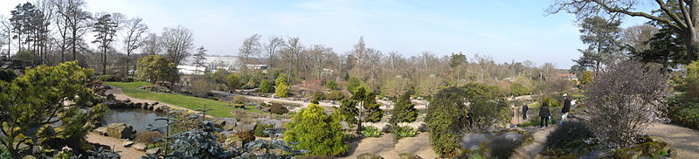
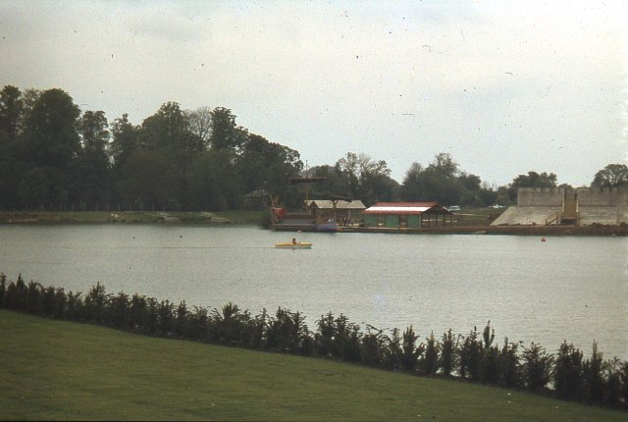
RHS Garden, Wisley
The Royal Horticultural Society's garden at Wisley
Thorpe Park
Thorpe Park Resort is a theme park in between the towns of Chertsey and Staines, Surrey, England.

Slide 6
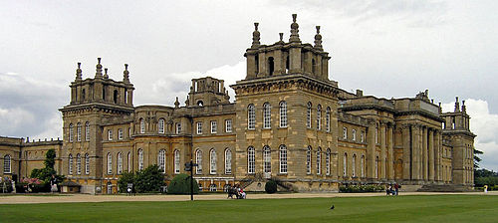
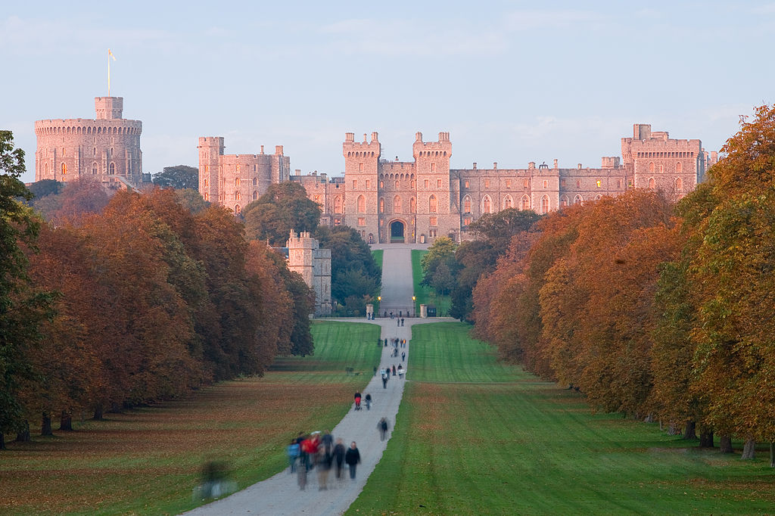
Blenheim Palace
Blenheim Palace is a monumental country house situated in Woodstock, Oxfordshire, England. It is the principal residence of the dukes of Marlborough, and the only non-royal non-episcopal country house in England to hold the title of palace.
Windsor Castle is a royal residence at Windsor in the English county of Berkshire. The castle is notable for its long association with the English and later British royal family and also for its architecture. The original castle was built in the 11th century after the Norman invasion by William the Conqueror.
Windsor Castle

Slide 7
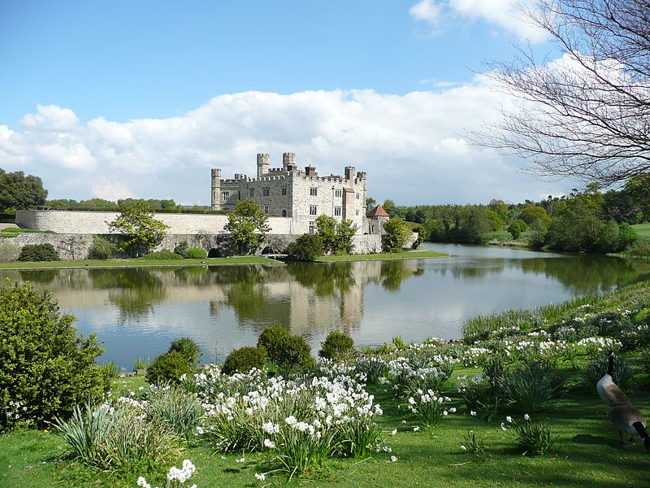
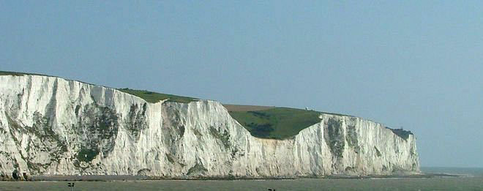
Leeds Castle is in Kent, England, 5 miles (8 km) southeast of Maidstone. A castle has been on the site since 1119.
Leeds Castle
The White Cliffs of Dover
The White Cliffs of Dover are cliffs which form part of the English coastline facing the Strait of Dover and France. The cliffs are part of the North Downs formation.

Slide 8

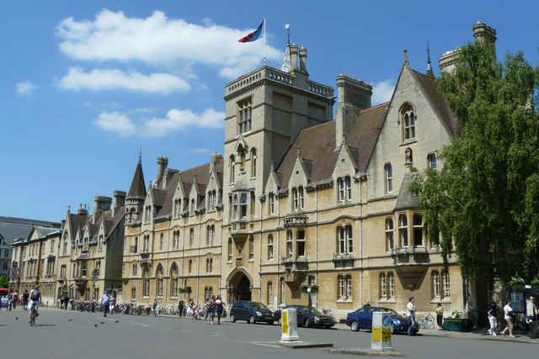
The University of Oxford (informally Oxford University or simply Oxford) is a collegiate research university located in Oxford, England. While having no known date of foundation, there is evidence of teaching as far back as 1096, making it the oldest university in the English-speaking world, and the world's second-oldest surviving university.

Slide 9

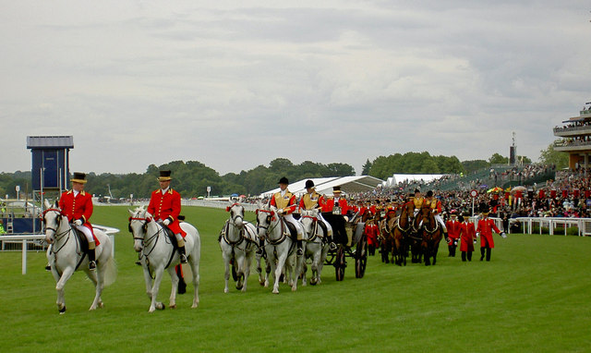
South East England is host to various sporting events, including the annual Henley Royal Regatta, Royal Ascot and the Epsom Derby, and sporting venues include Wentworth Golf Club and Brands Hatch. Some of the events of the 2012 Summer Olympics were held in the South East, including the rowing at Eton Dorney and part of the cycling road race in the Surrey Hills.

Slide 10


