Slide 1
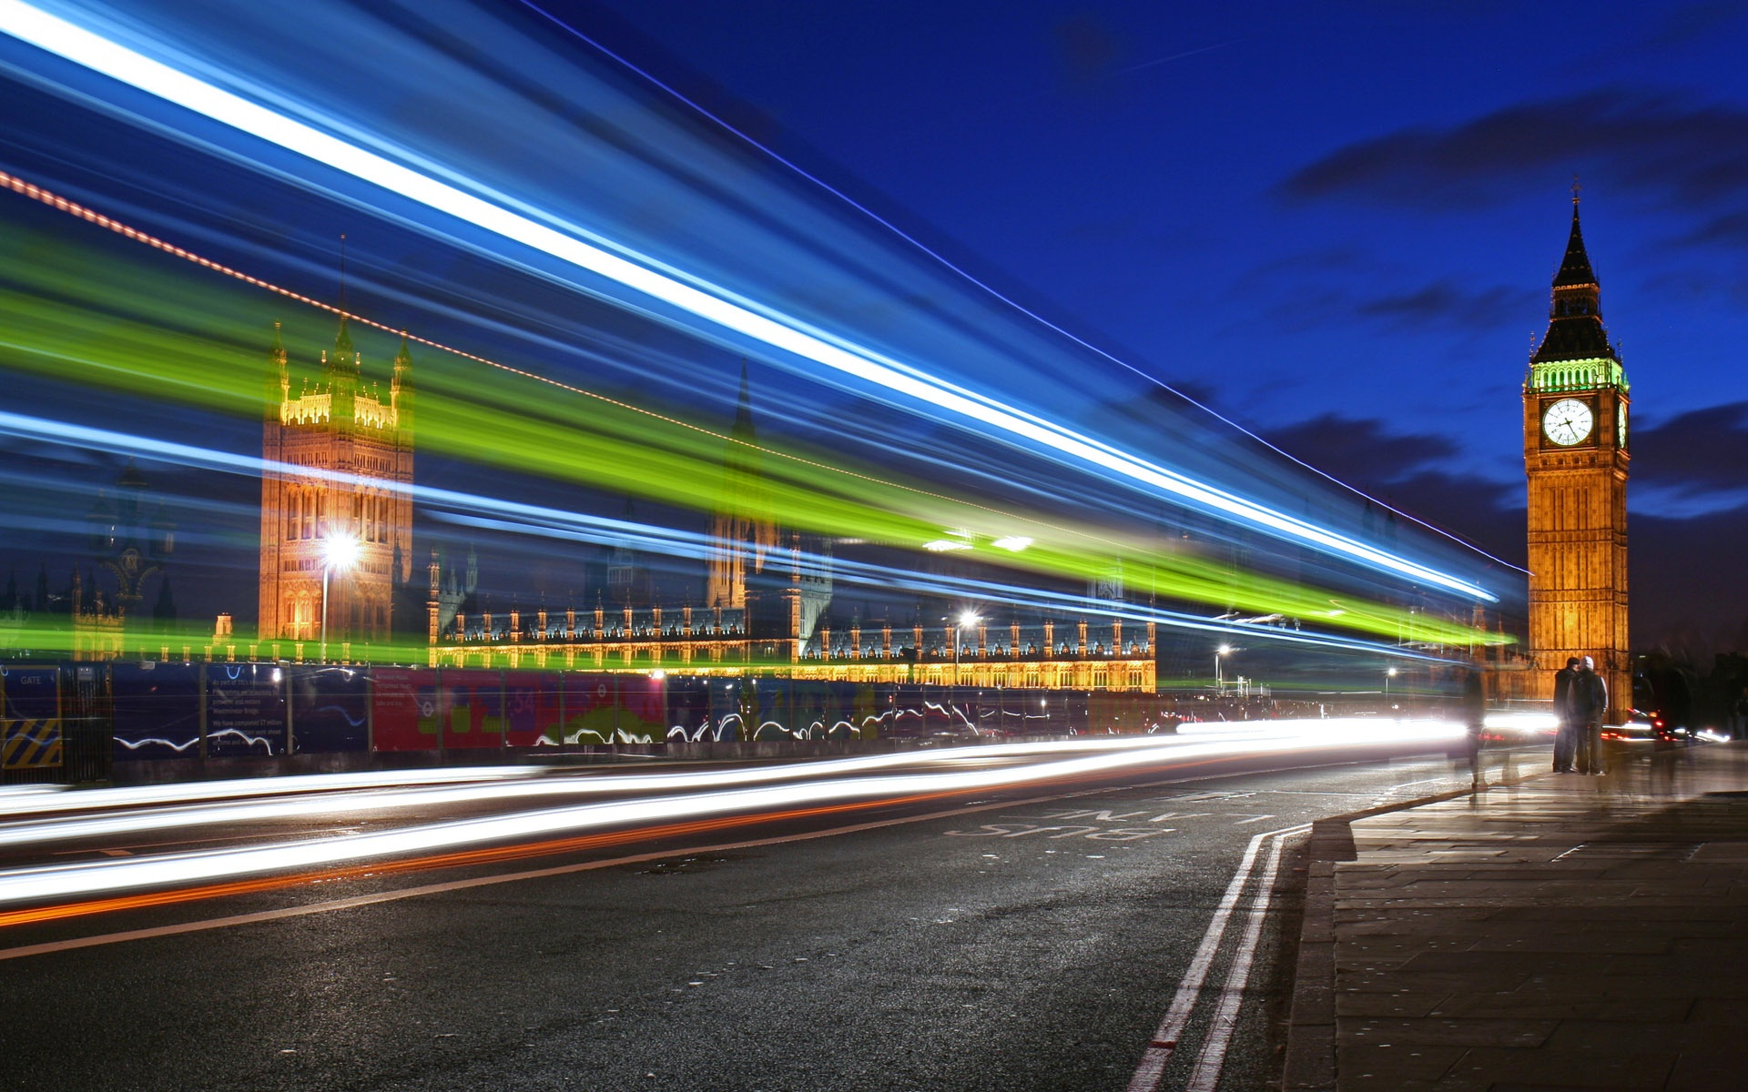
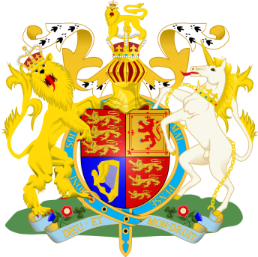
The United kingdom of great Britain and northern Ireland.
BEGIN
Заказ #0009

Slide 2
PLAN
Geography
THE FLAG
Government
London
Administrative divisions
The Nature
Culture
Attraction
LITERATURE

Slide 3
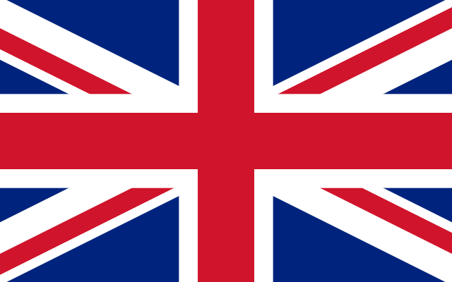
Geography
The United Kingdom of Great Britain and Northern Ireland is situated on the British Isles. The British Isles are separated from European continent by the North Sea and the English Channel.

Slide 4
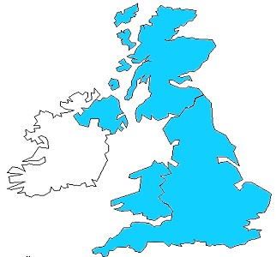
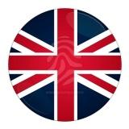
Where is the UK?
The UK is situated on the British Isles, north-west of the European continent between the Atlantic Ocean and the North sea.
Great Britain
Northern Ireland
The official name of
the UK is the "United Kingdom of Great Britain and Northern Ireland".

Slide 5
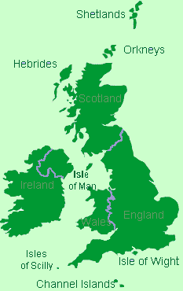
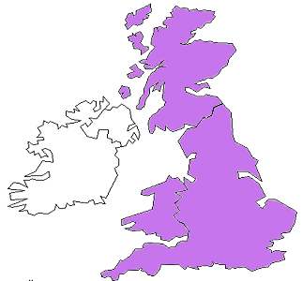
THE BRITISH ISLES
Is Great Britain the same as the UK?
NO!
Great
Britain
Ireland
Great Britain
The UK
People in the UK are called British although they have different
If you look at the full name of the UK,
you will see that the UK includes Great
Britain AND Northern Ireland.
nationalities.

Slide 6
THE FLAG
The flag of the United Kingdom (the Union Jack) consists of three crosses. The big red cross is the cross of Saint George, the patron saint of England. The white cross is the cross of Saint Andrew, the patron saint of Scotland. The red diagonal cross is the cross of Saint Patrick, the patron saint of Ireland.

Slide 7
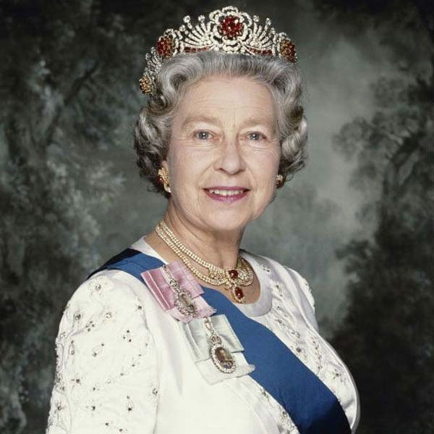
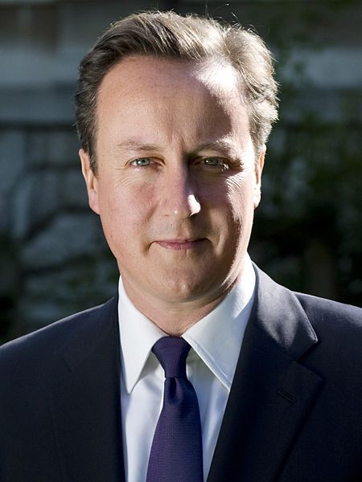
Government
The UK is a constitutional monarchy.
Elizabeth II (born 21 April 1926) is the constitutional monarch of 16 sovereign states, known as the Commonwealth realms, and their territories and dependencies, and head of the 53-member Commonwealth of Nations. She is Supreme Governor of the Church of England and, in some of her realms, carries the additional title of Defender of the Faith.
David William Donald Cameron (born 9 October 1966) is the Prime Minister of the United Kingdom, First Lord of the Treasury, Minister for the Civil Service and Leader of the Conservative Party. He represents Witney as its Member of Parliament (MP).

Slide 8
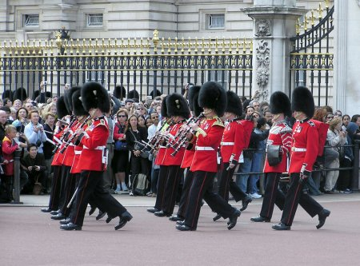
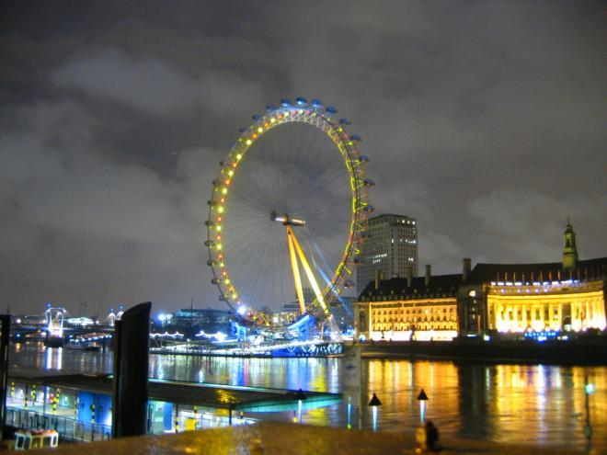
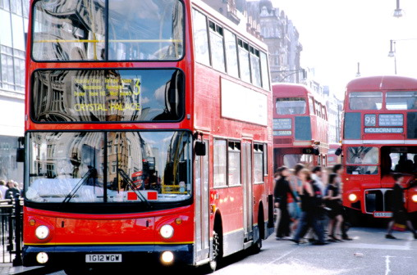
London
The capital of the UK is London. It is about two thousand years old. Now London is one of the biggest cities in the world and the largest city in Europe.

Slide 9
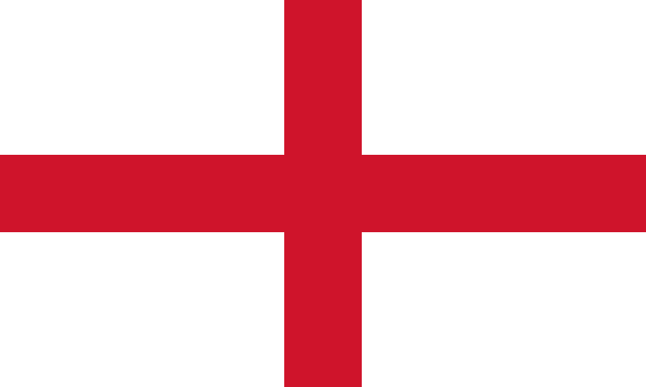
Administrative divisions
The UK consists of four main parts: England, Scotland, Wales and Northern Ireland. England is in the southern and central part of Great Britain. It is the richest, most fertile and most populated part of the country. London is the capital of England.
ENGLAND

Slide 10
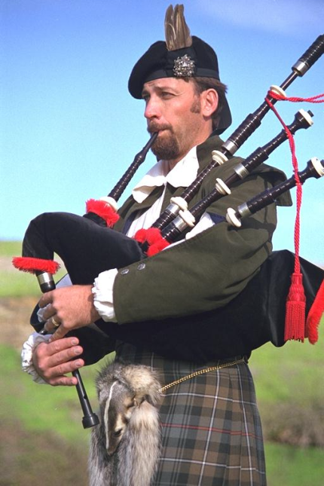
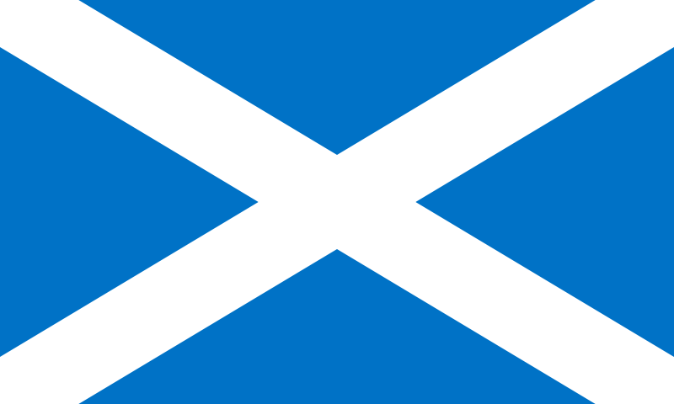
Administrative divisions
Scotland is the most mountainous region with the highest peak, Ben Nevis.
It is divided into three regions:
the Highlands
the Lowlands
the Southern Uplands
The capital of Scotland is Edinburg.
The Scottish are wearing kilts.
SCOTLAND

Slide 11
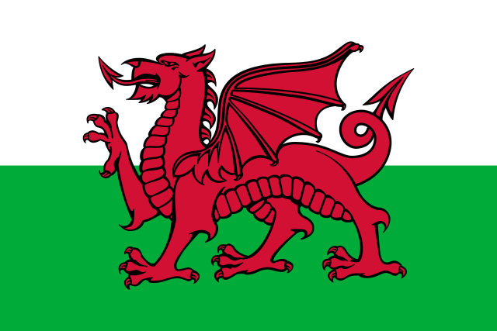
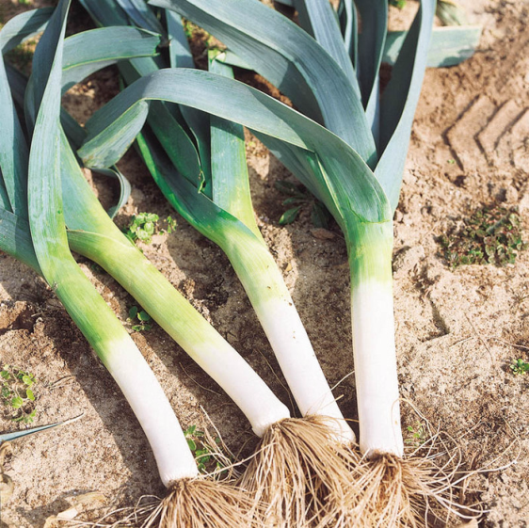
Administrative divisions
The capital of Wales is Cardiff. Wales is a country of lakes. In Wales people speak English and Welsh. Welsh is very different from English.
The leek is the emblem of Wales.
WALES

Slide 12
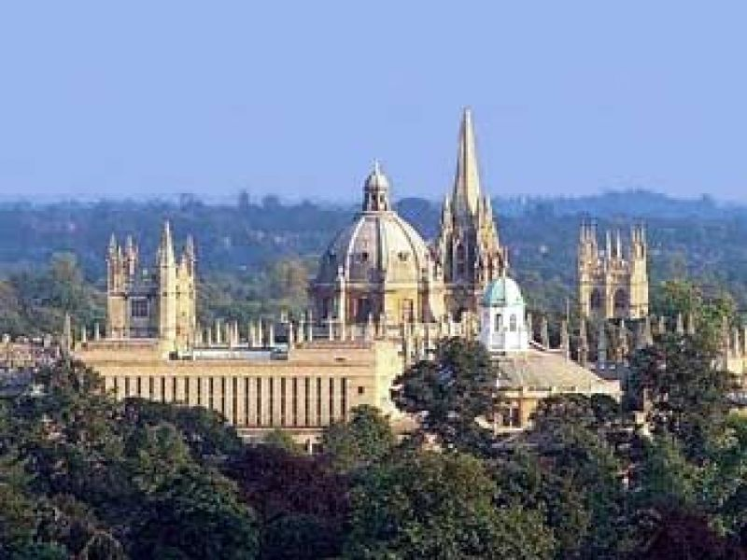
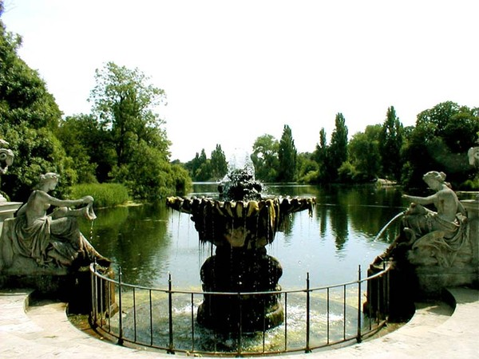
The Nature
Great Britain is rich in world-famous places. Certainly among them there are famous university cities Oxford and Cambridge, Shakespeare’s birthplace - Stratford-upon-Avon, Hide Park, The tower of London, the Palace of Westminster and etc.

Slide 13
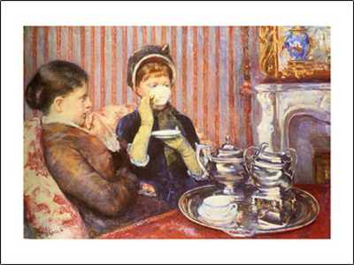
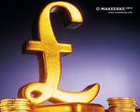
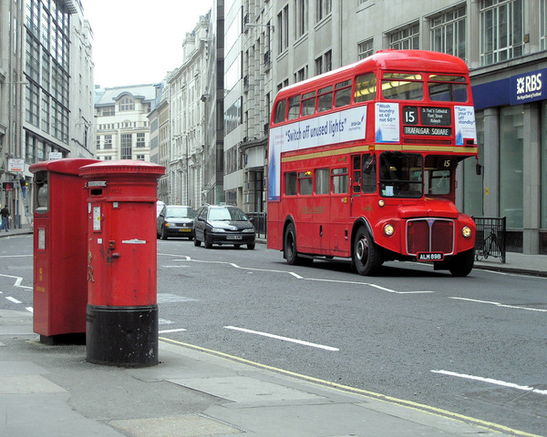
Culture
Traditions play the most important role in the life of the people than in other countries. The best examples are their Queen, money system, their weights and measures. Englishmen are proud of their traditions and carefully keep them.

Slide 14
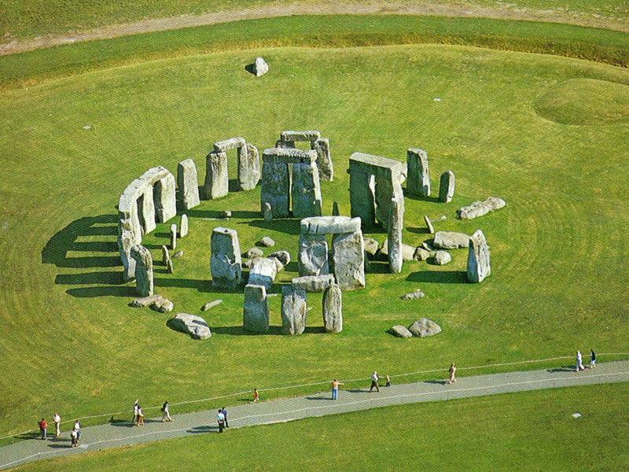
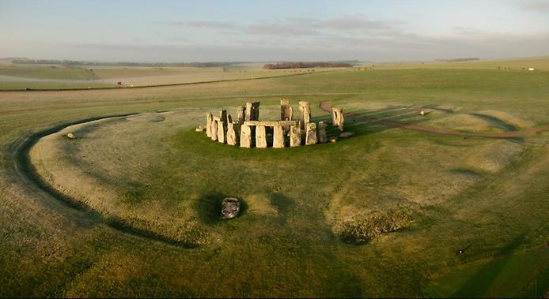
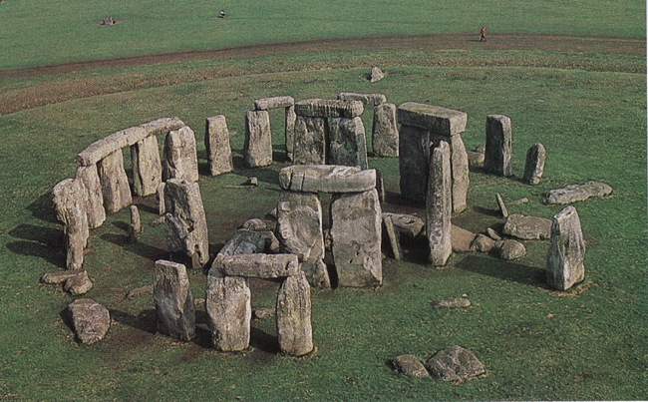
Attraction
There is prehistoric monument in Great Britain which is as interesting as Egyptian pyramids. This is Stonehenge. Stones stand here in circles. Scientists think that Stonehenge was built to calculate the annual calendar and seasons.

Slide 15
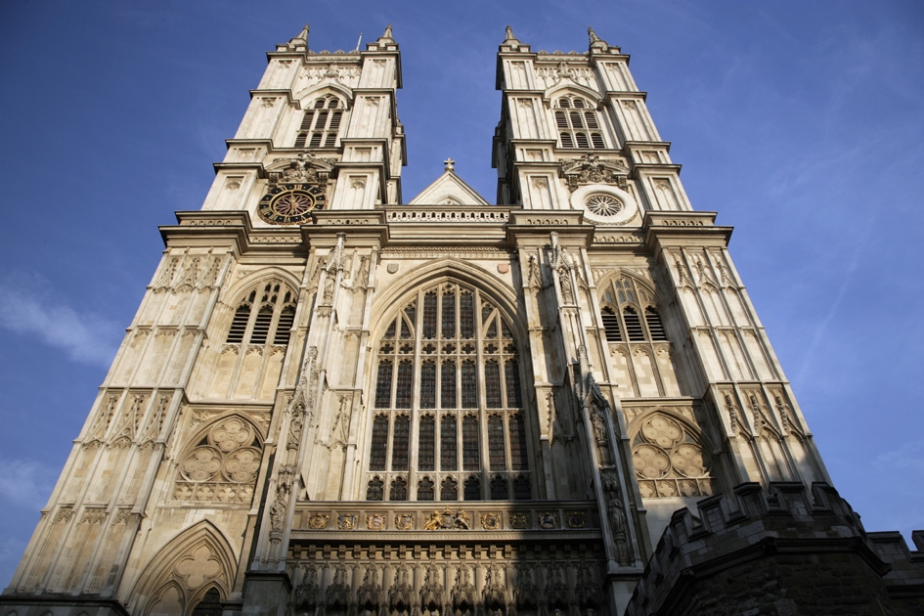
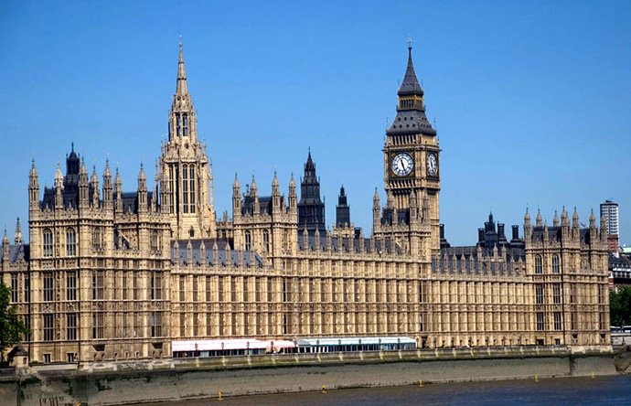
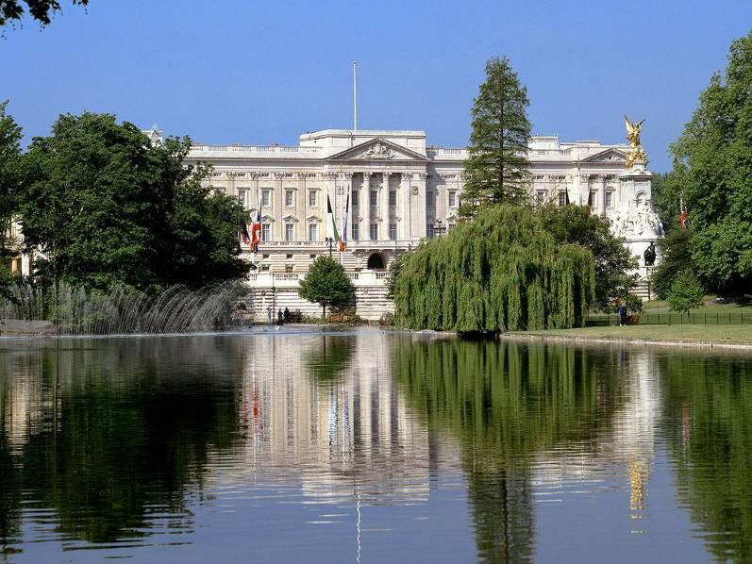
Attraction
The Collegiate Church of St Peter at Westminster, which is almost always referred to popularly and informally as Westminster Abbey,
is a large, mainly Gothic church, in Westminster, London. It is the traditional place of coronation of British monarchs.
The Palace of Westminster, also known as the Houses of Parliament or Westminster Palace, is the meeting place of the two houses of the Parliament of the United Kingdom — the House of Lords and the House of Commons
Buckingham Palace – Queen’s Residence

Slide 16
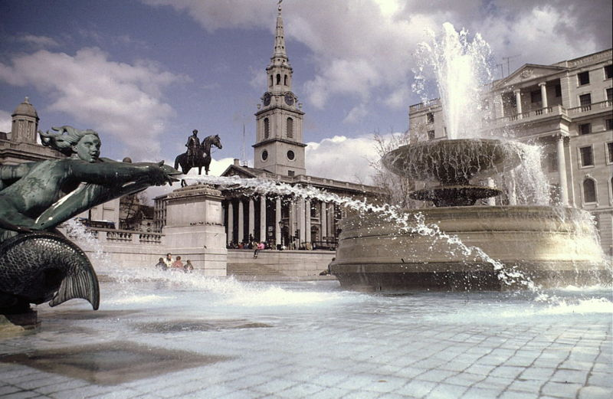
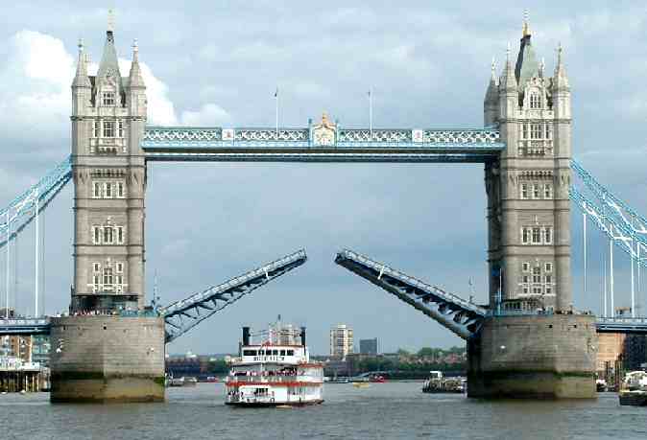
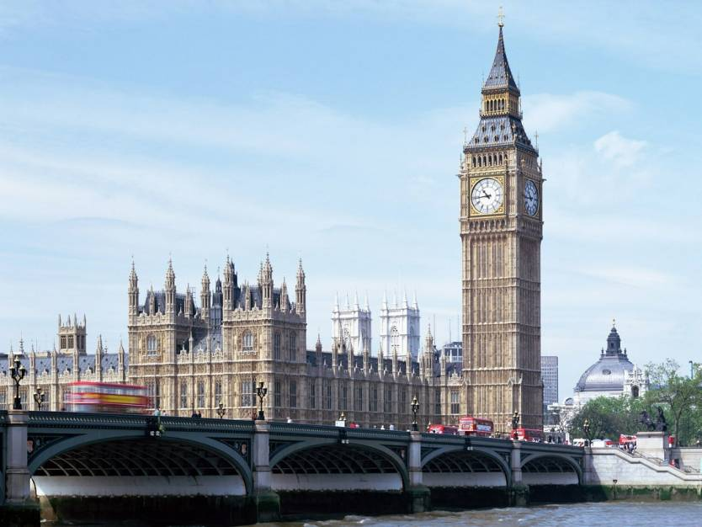
Attraction
Trafalgar Square is a tourist attraction, and one of the most famous squares in the UK and the world. At its centre is Nelson’s Column’s, which is guarded by four lion statues at its base. The square is also used as a location for political demonstrations and community gatherings, such as the celebration of New Year's Eve in London.
Tower Bridge is a combined bascule and suspension bridge in London, over the River Thames. It is close to the Tower of London, which gives it its name.
Big Ben is the nickname for the great bell of the clock at the north end of the Palace of Westminster in London, and is often extended to refer to the clock or the clock tower as well.

Slide 17
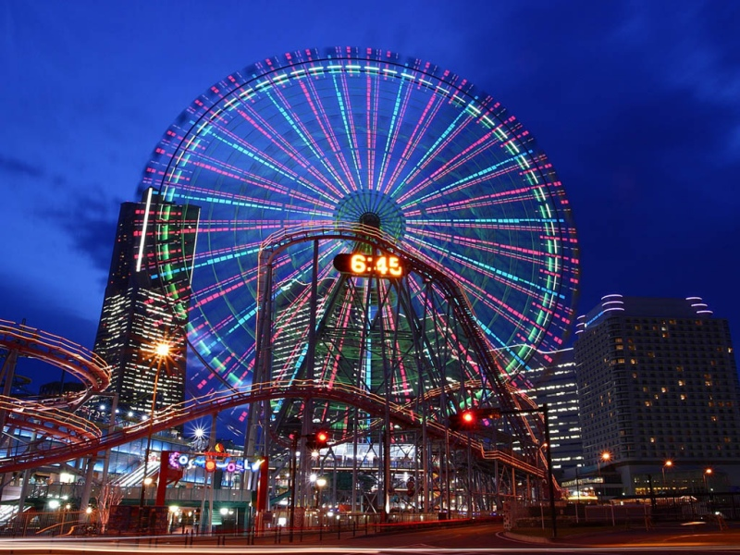
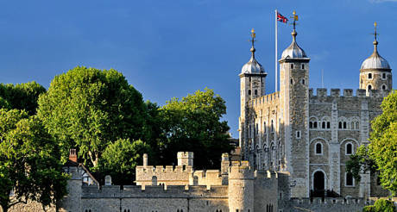
Attraction
Her Majesty's Royal Palace and Fortress, more commonly known as the Tower of London, is a historic castle and scheduled monument in central London, on the north bank of the River Thames.
The Merlin Entertainments London Eye (commonly the London Eye, or Millennium Wheel)
is an extremely large passenger-carrying Ferris wheel situated on the banks of the River Thames in Central London in the United Kingdom. It is the largest Ferris wheel in Europe, and has become the most popular paid tourist attraction in the United Kingdom

