Slide 1
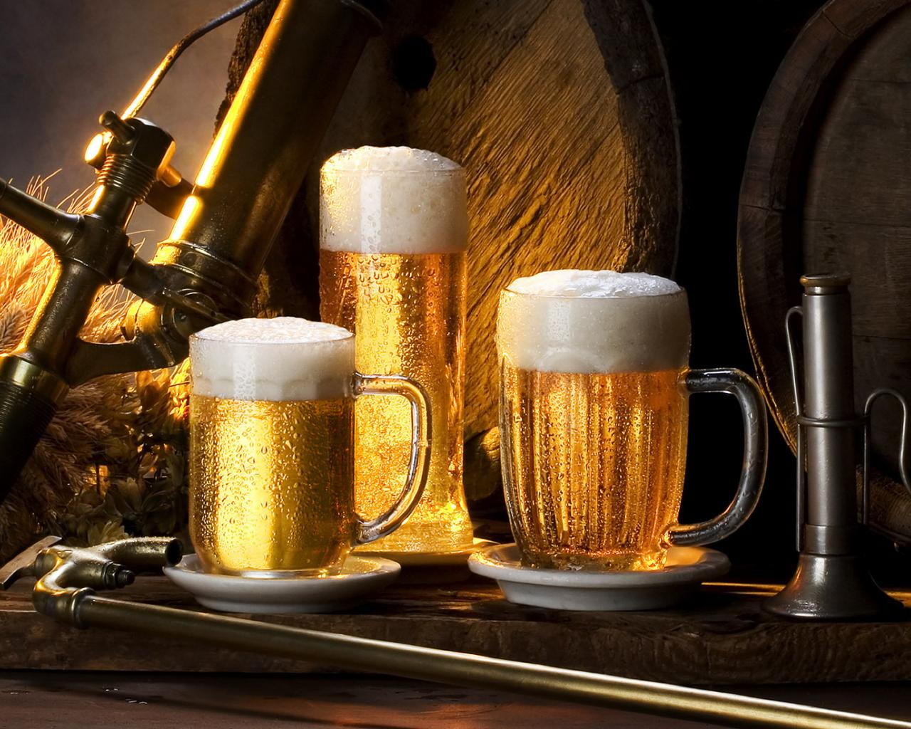
PUB

Slide 2
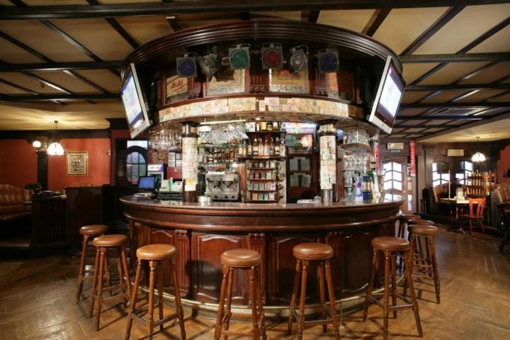
Pub
A , formally public house (a house "open to the public", as opposed to a private house), is a drinking establishment fundamental to the culture of Britain, Ireland, Australia, Newfoundland, South Africa and New Zealand. In many places, especially in villages, a pub can be the focal point of the community. The writings of Samuel Pepys describe the pub as the heart of England.

Slide 3
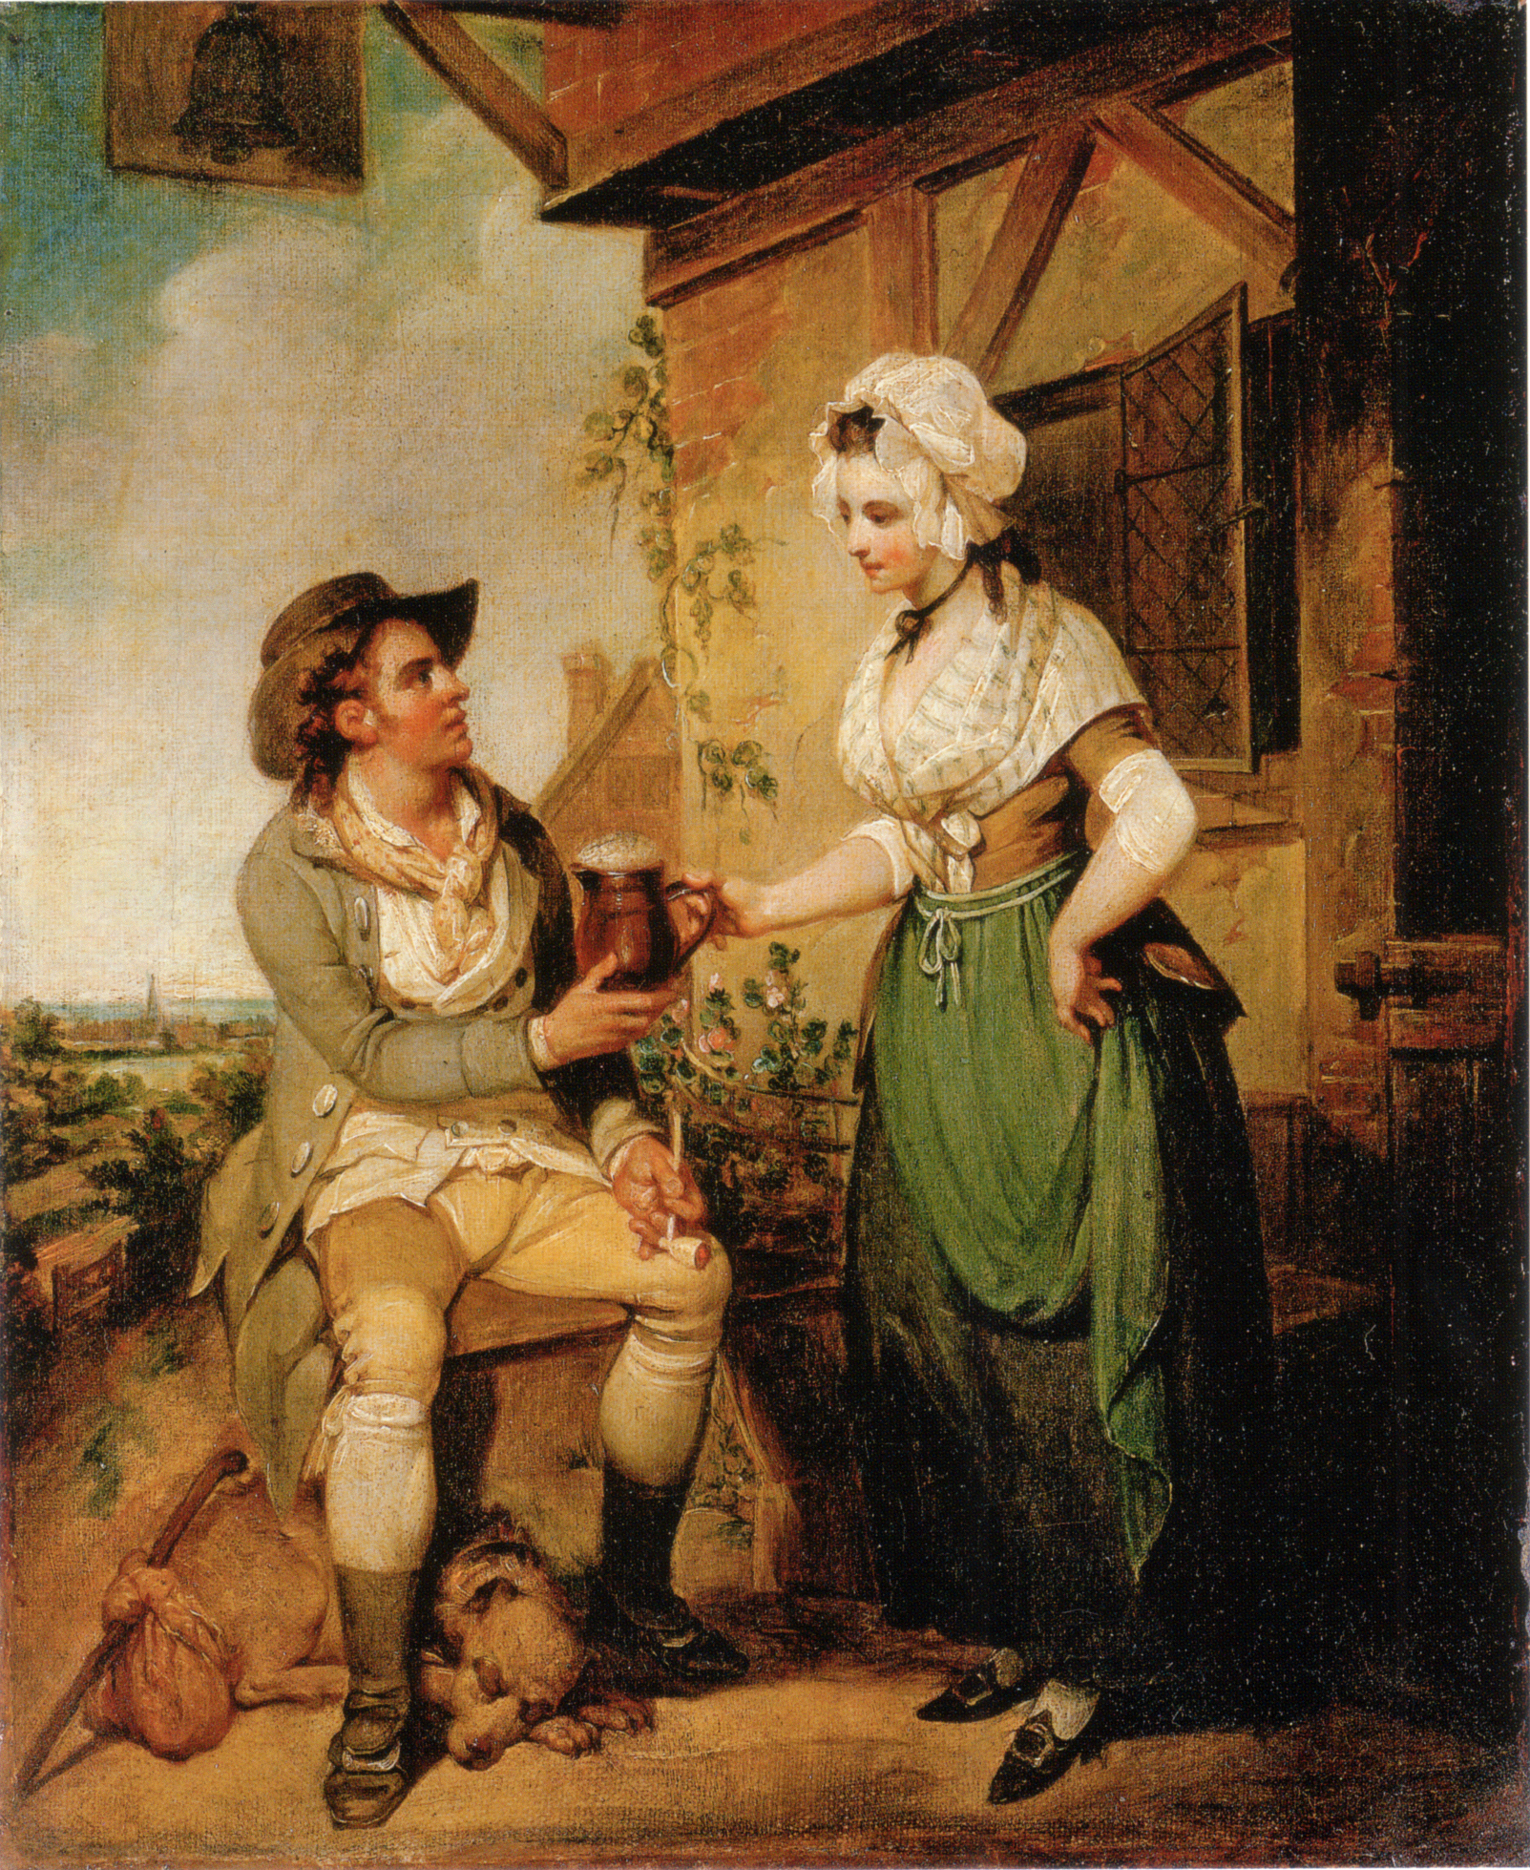
History
The inhabitants of Great Britain have been drinking ale since the Bronze Age, but it was with the arrival of the Romans and the establishment of the Roman road network that the first inns called tabernae, in which the traveller could obtain refreshment, began to appear. After the departure of Roman authority and the fall of the Romano-British kingdoms, the Anglo-Saxons established alehouses that grew out of domestic dwellings. The Anglo-Saxon alewife would put a green bush up on a pole to let people know her brew was ready. These alehouses formed meeting houses for the villagers to meet and gossip and arrange mutual help within their communities. Here lie the beginnings of the modern pub. They became so commonplace that in 965 King Edgar decreed that there should be no more than one alehouse per village.

Slide 4
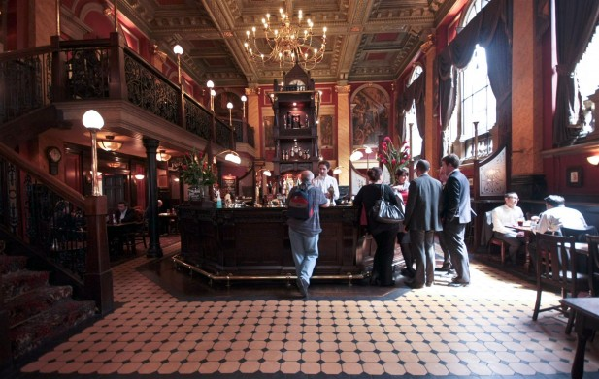
Particular kinds of pubs
Country pubs
Theme pubs

Slide 5
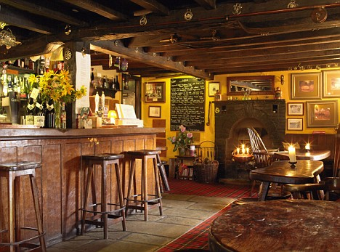
Country pubs
A "country pub" by tradition is a rural public house. However, the distinctive culture surrounding country pubs, that of functioning as a social centre for a village and rural community, has been changing over the last thirty or so years. In the past, many rural pubs provided opportunities for country folk to meet and exchange (often local) news, while others—especially those away from village centres—existed for the general purpose, before the advent of motor transport, of serving travellers as coaching inns.

Slide 6
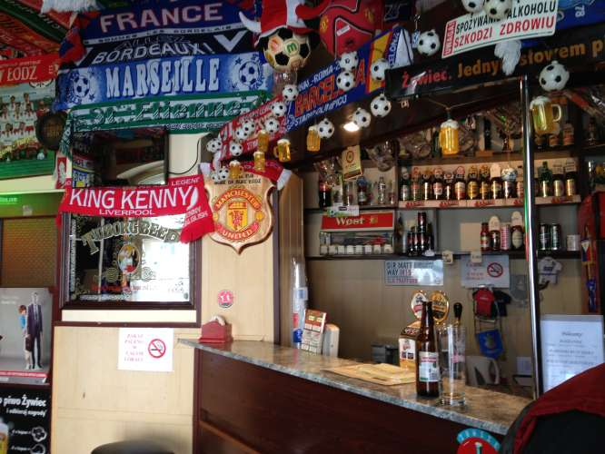
Theme pubs
Pubs that cater for a niche clientele, such as sports fans or people of certain nationalities are known as theme pubs. Examples of theme pubs include sports bars, rock pubs, biker pubs, Goth pubs, strip pubs, gay bars, karaoke bars and Irish pubs.

Slide 7
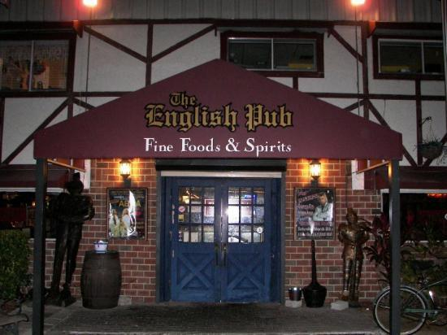
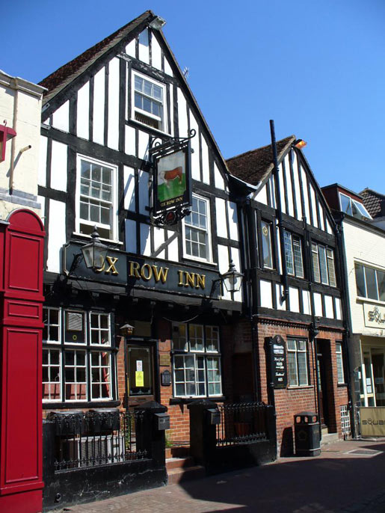
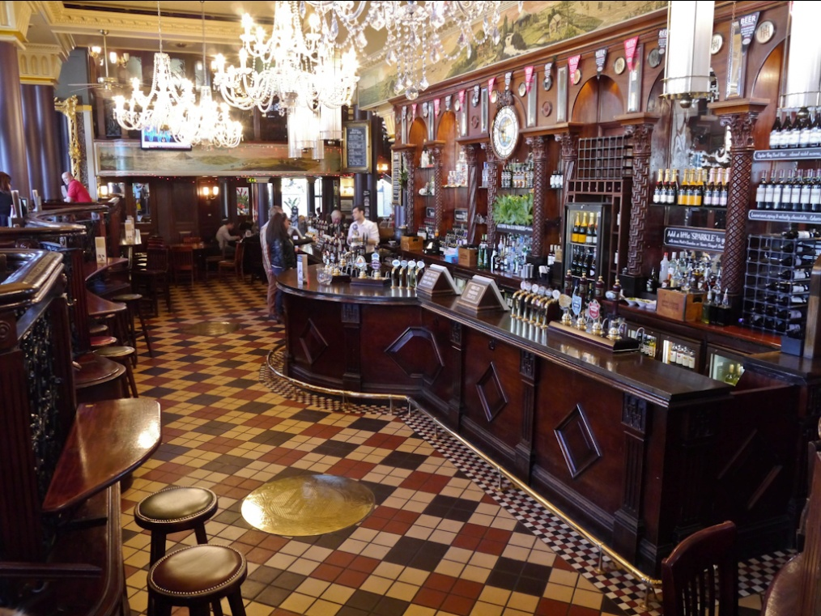

Slide 8
