Slide 1
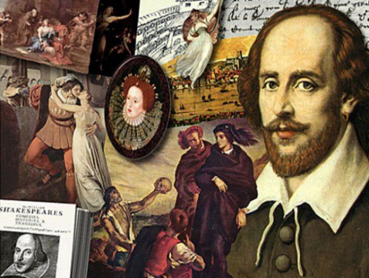
The life of William Shakespeare

Slide 2
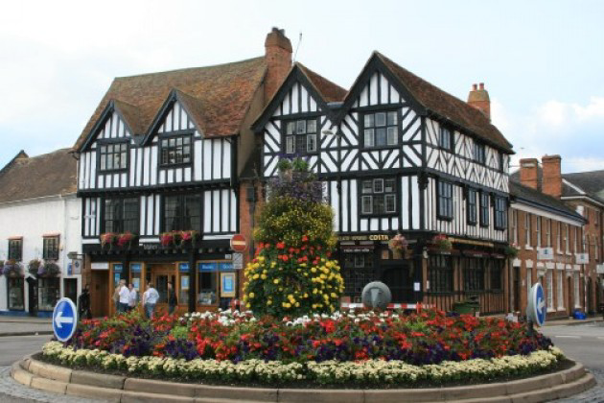
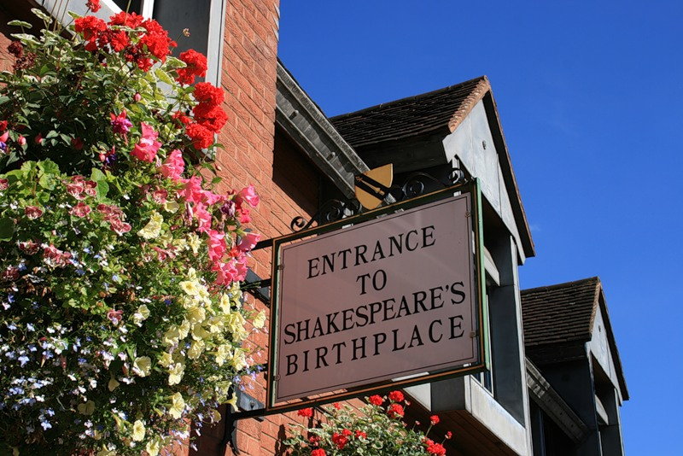
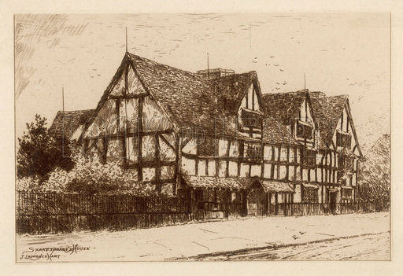
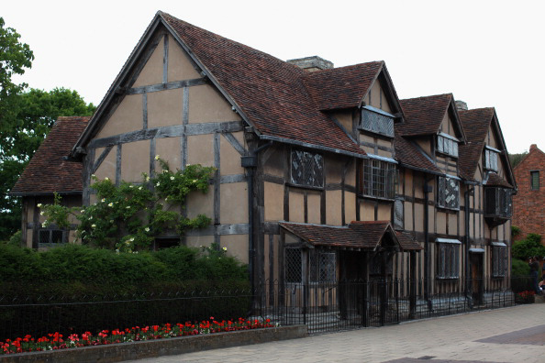
April 23, 1564
Stratford-upon-Avon

Slide 3
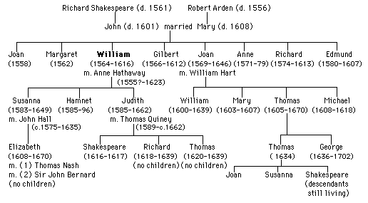
Gilbert Shakespeare’s signature witnessing a deed dated 5 March 1610.

Slide 4
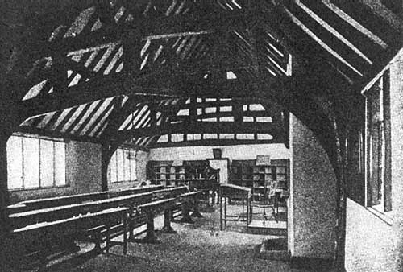
School
A classroom. Shakespeare set in the left corner near the shelves.

Slide 5
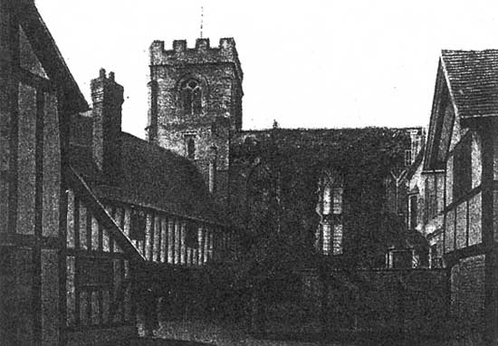
School
The back facade and playing ground.

Slide 6
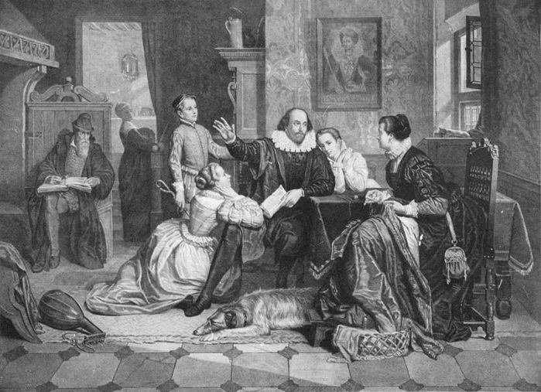
William Shakespeare and his wife Anne Hathaway.

Slide 7
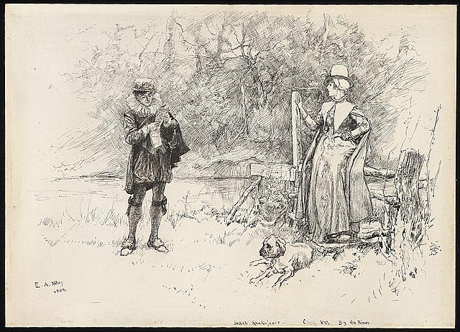
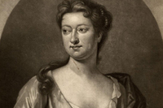
Children
Judith Quiney
Susanna Shakespeare

Slide 8
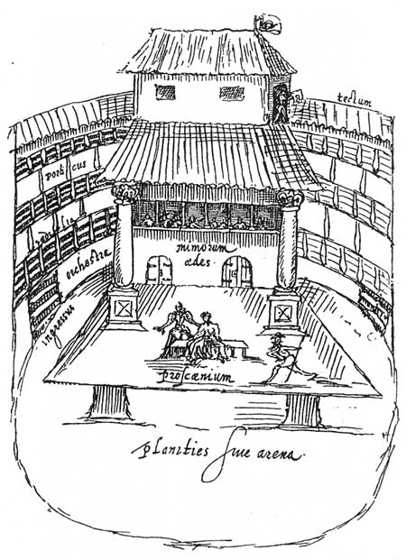
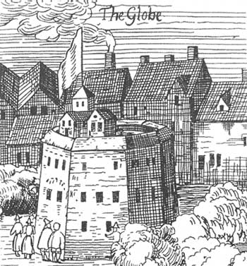
Model of the old theater where Shakespeare worked.
Theater "Globe"; engraving.

Slide 9
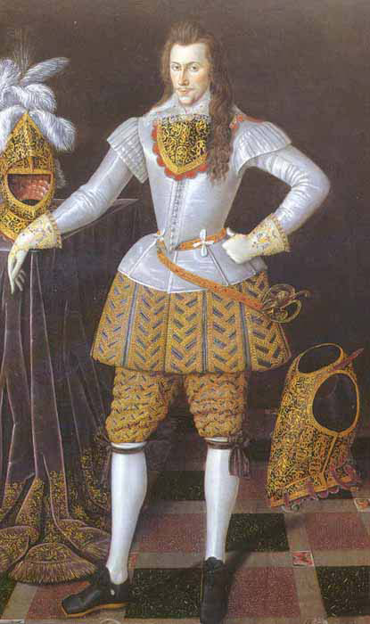
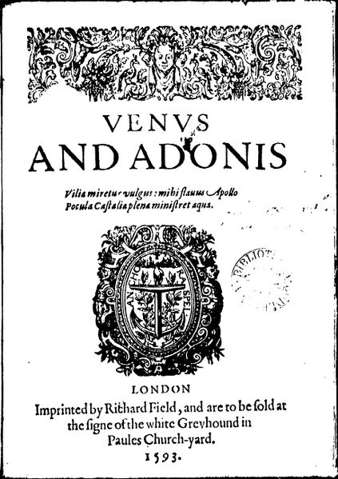
Henry Risley, Count of Southampton; 1590.

Slide 10
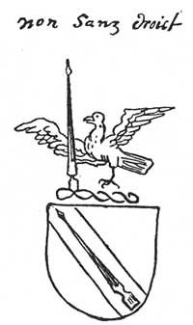
A blazon with a motto of family “Non Sanz Droict ” – “ Not without a right”.

Slide 11
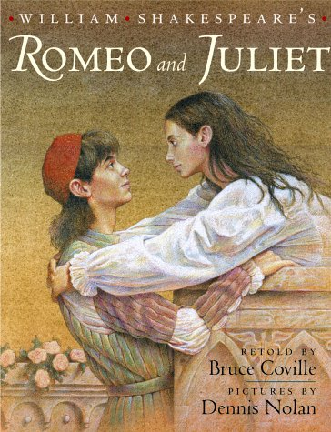
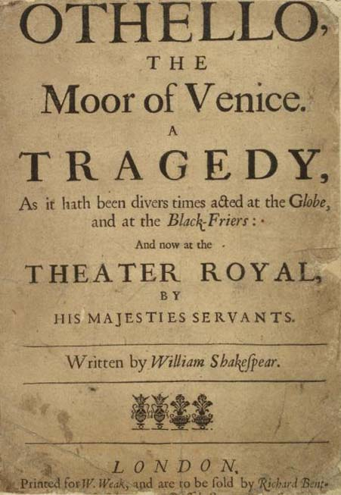
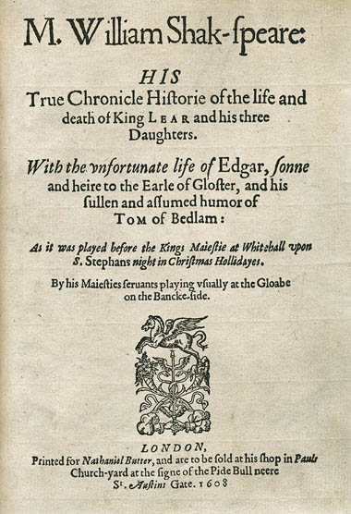
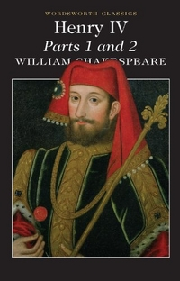
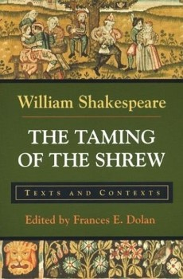
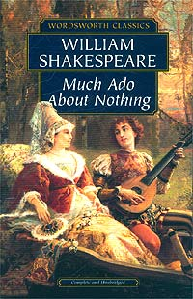
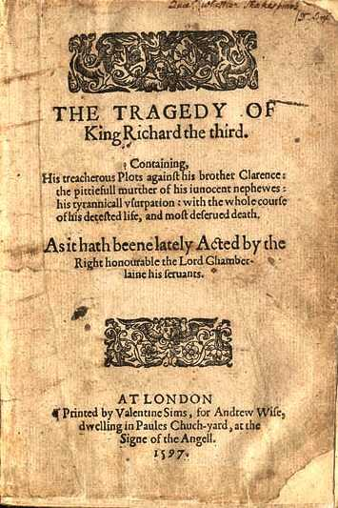

Slide 12
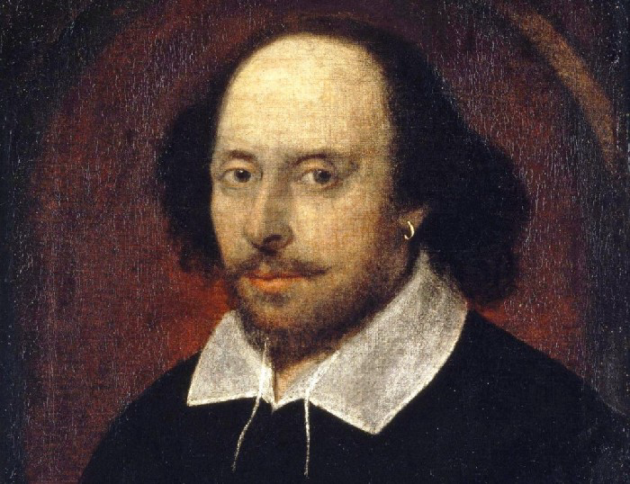
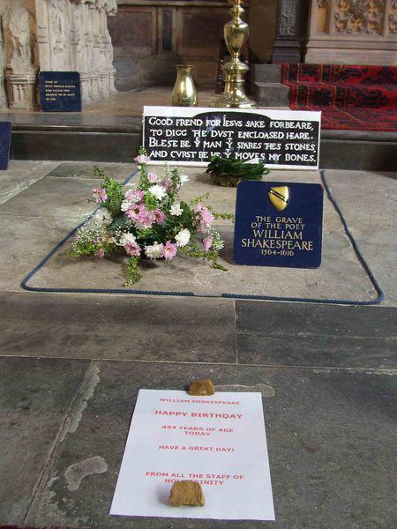
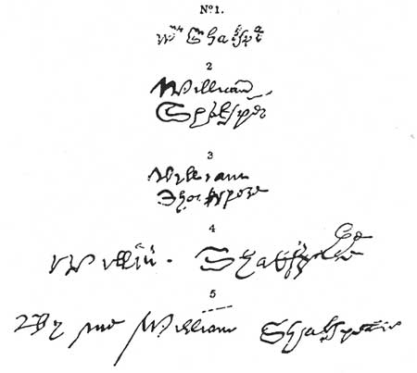
Five extant signatures of Shakespeare.
Stratford-upon-Avon

Slide 13
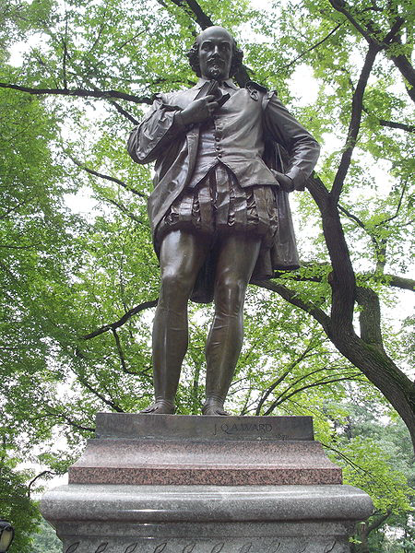
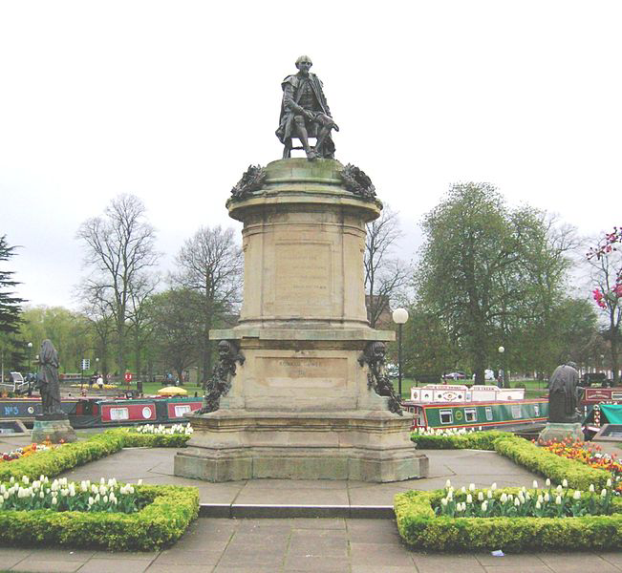
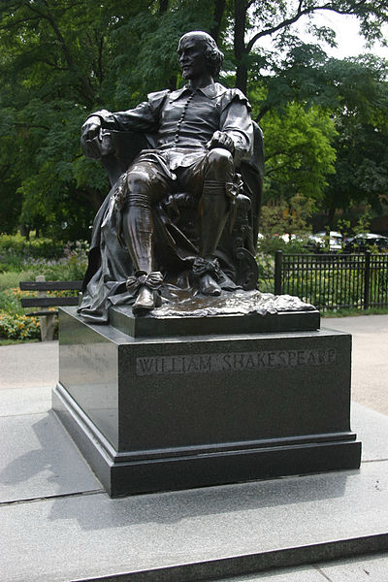
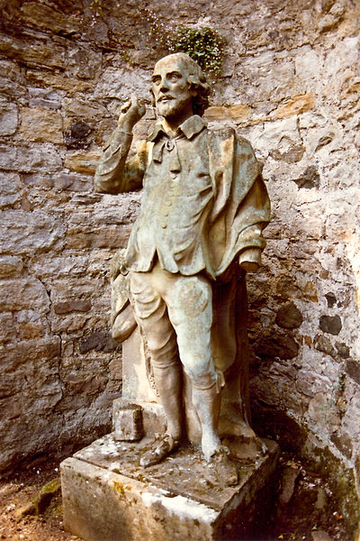
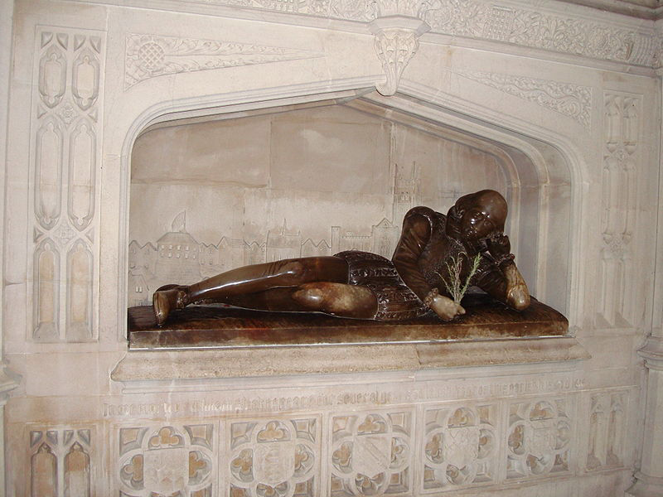
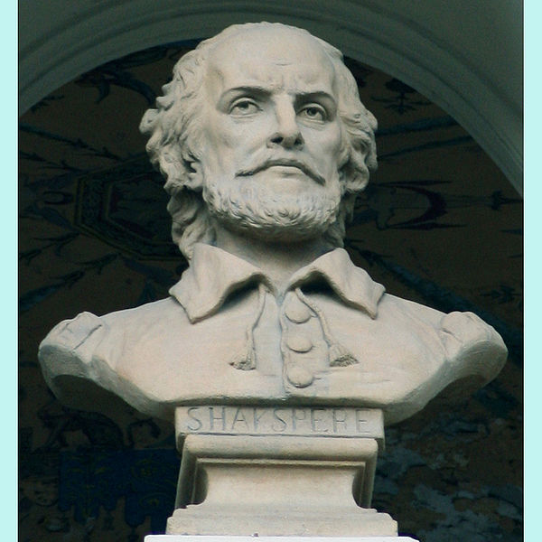
The monument in Stratford-upon-Avon, designed by Lord Ronald Gower.
William Parker Ordway's statue in Chicago.
Statue in Central Park, New York, by John Quincy Adams Ward, 1872.
Bust of Shakespeare on the National Theatre building, Hviezdoslav Square, Bratislava.
Coade stone statue of Shakespeare at Bonaly Tower, Edinburgh.
Memorial in Southwark Cathedral, London.

Slide 14
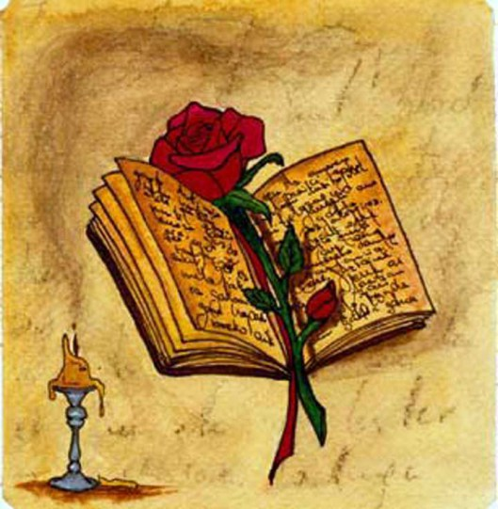
Thank you for your kind attention!

