Slide 1
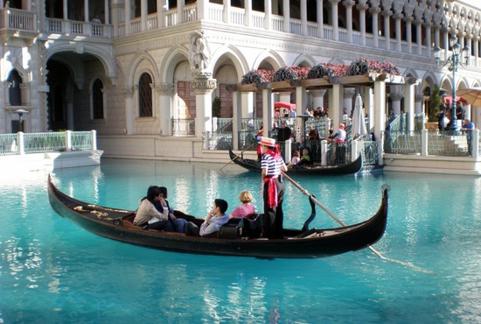
Gondola

Slide 2
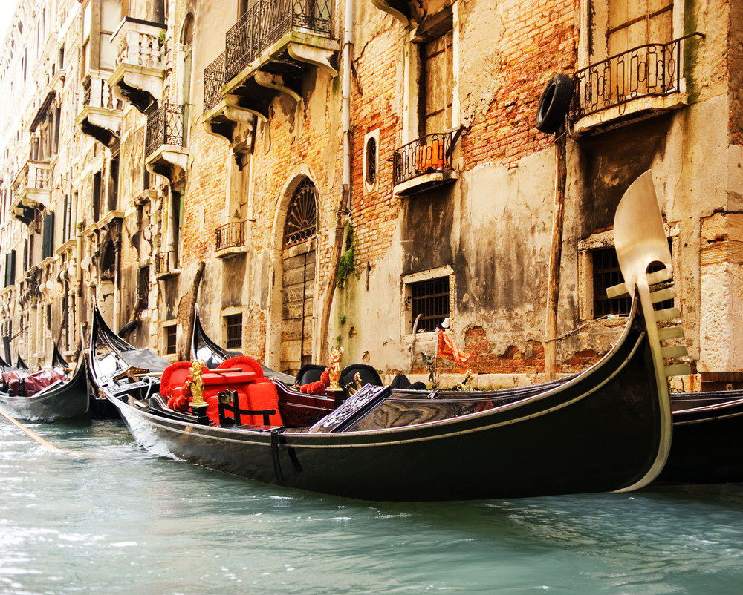
The gondola is a traditional, flat-bottomed Venetian rowing boat, well suited to the conditions of the Venetian lagoon.

Slide 3
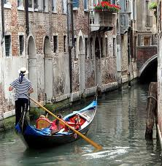
The gondola is propelled like punting, except an oar is used instead of a pole

Slide 4
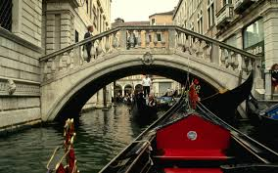
For centuries gondolas were the chief means of transportation and most common watercraft within Venice. In modern times the iconic boats still have a role in public transport.

Slide 5
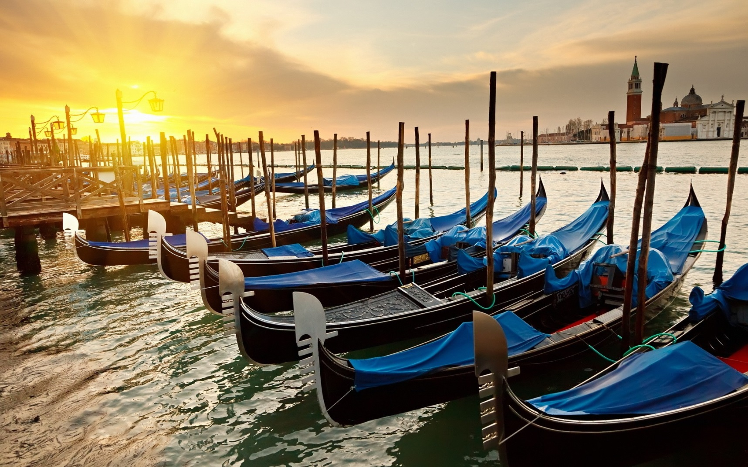
It is estimated that there were eight to ten thousand gondolas during the 17th and 18th century. There are just over four hundred in active service today, virtually all of them used for hire by tourists.

Slide 6
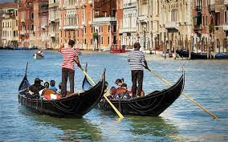
Those few that are in private ownership are either hired out to Venetians for weddings or used for racing.

Slide 7
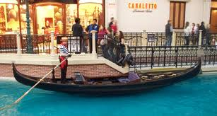
During their heyday as a means of public transports, teams of four men—three oarsmen and a fourth person, primarily shore-based and responsible for the booking and administration of the gondola

Slide 8
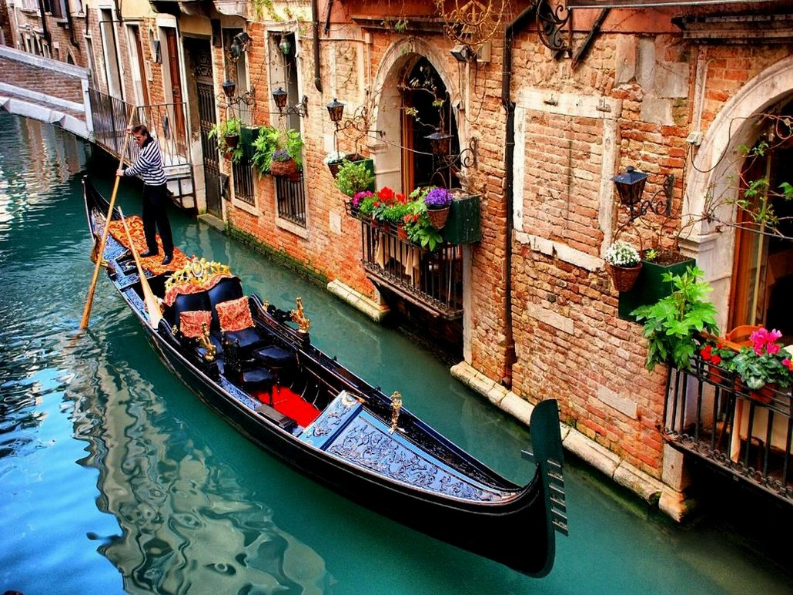
The profession of gondolier is controlled by a guild, which issues a limited number of licenses (425) granted after periods of training and apprenticeship, and a major comprehensive exam

Slide 9
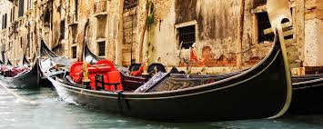
The origin of the word "gondola" has never been satisfactorily established, despite many theories

Slide 10
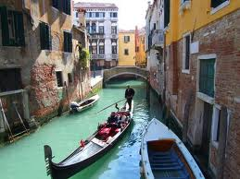
In August 2010, Giorgia Boscolo became Venice's first female gondolier

Slide 11
THE END

