Slide 1
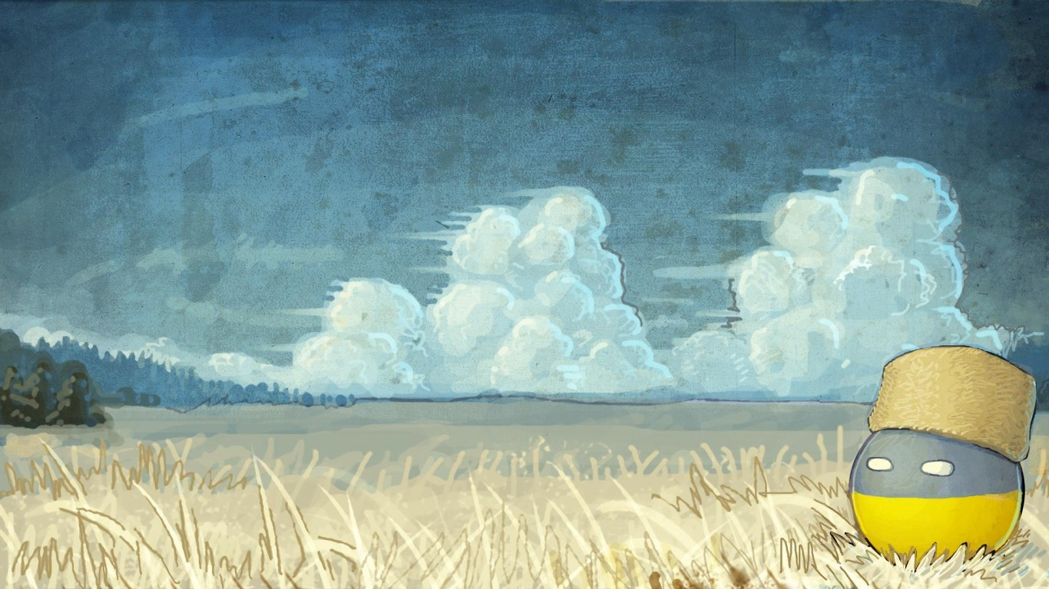
Ukrainians' lifestyle
Bogatyr Bogdana
8-A

Slide 2

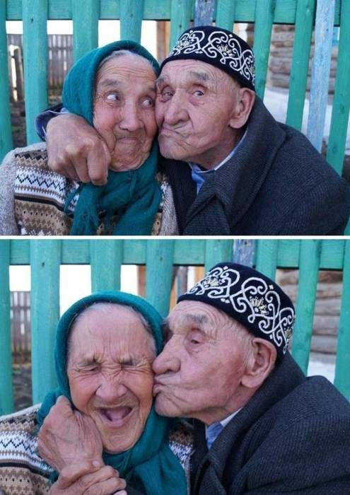
Ukrainians live longer nowadays.
On average, people live for 69 for men and 75 for women.
This age could be longer, but a lot of people have unhealthy lifestyle.

Slide 3
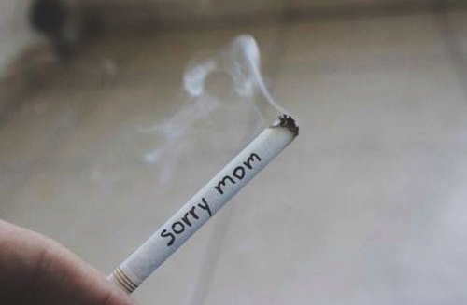

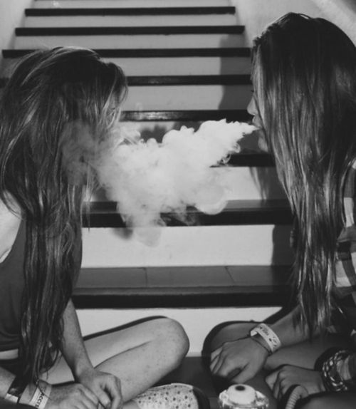
About nine million people smoke, it’s a third of all working people. In Ukraine every second man and every fifth woman smoke. However, the number of smokers have reduced in two times since 2005.
The bad news is that 30% of young people from 13 to15 years old smoke.

Slide 4
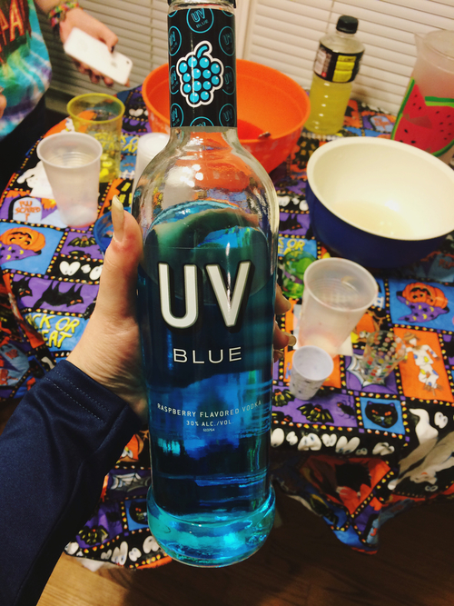

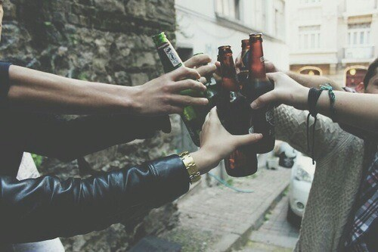
In Ukraine people drink a lot of alcohol. On average, every person drinks 12 liters of alcohol and 60 liters of beer per year.

Slide 5

People eat more fruit and vegetables but
about two-thirds of people are overweight

Slide 6

Most people in Ukraine work, but than more 9% don’t have work.
More than 2 million people work in Europe. The most popular jobs are in computers and bankers but the professions of a doctor and a lawyer are becoming more popular. Most young people get higher education, but it’s very difficult to find a job after university.

Slide 7
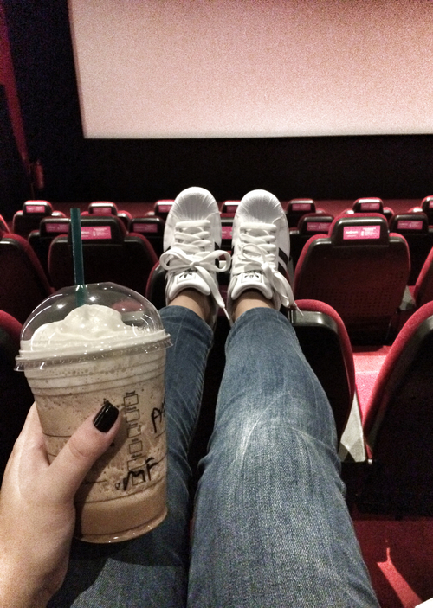
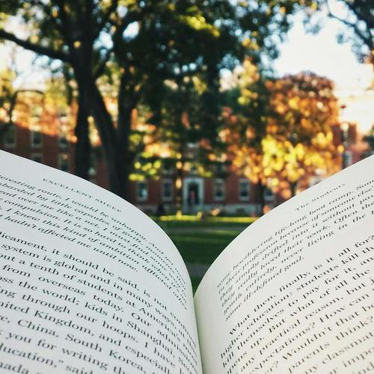
What do Ukrainians do in free time?
They read little and only sometimes go to the cinema.

Slide 8

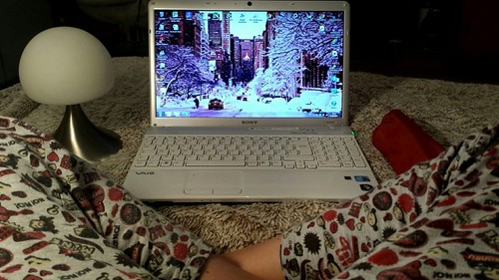
Children and teenagers watch TV less, but they spend a lot of time on computers. The biggest Internet users are 13-24 year-olds.

Slide 9
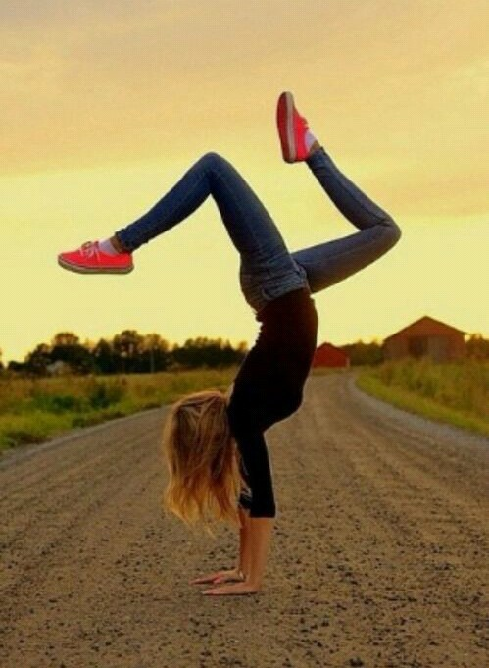

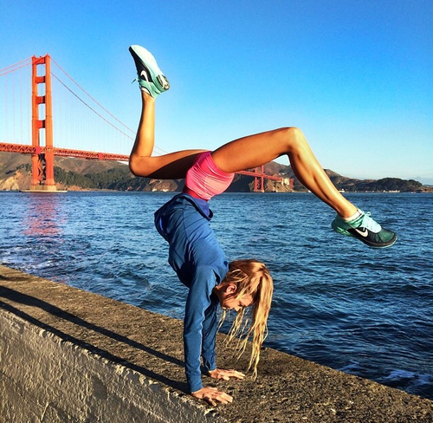


The good news is that mane people like sports. The most popular sports in Ukraine are football, basketball, volleyball, swimming and skating.

Slide 10

I believe that ukrainians are smart, hard-working and we tray to change our life for better.

