Slide 1
Traditional English cuisine

Slide 2
Maintains
English cuisine
English Muffins
How to make better muffins

Slide 3
English cuisine
English cuisine encompasses the cooking styles, traditions and recipes associated with England. It has distinctive attributes of its own, but also shares much with wider British cuisine, largely due to the importation of ingredients and ideas from places such as North America, China, and India during the time of the British Empire and as a result of post-war immigration.

Slide 4
In the Early Modern Period the food of England was historically characterized by its simplicity of approach and a reliance on the high quality of natural produce. It is possible the effects of this can still be seen in traditional cuisine.
Traditional meals have ancient origins, such as bread and cheese, roasted and stewed meats, meat and game pies, boiled vegetables and broths, and freshwater and saltwater fish.

Slide 5
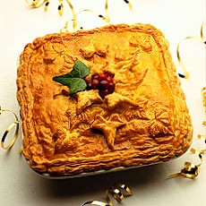
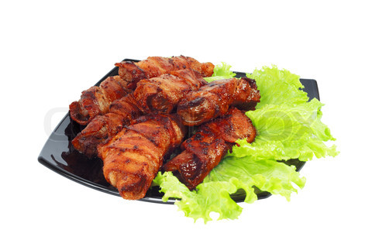
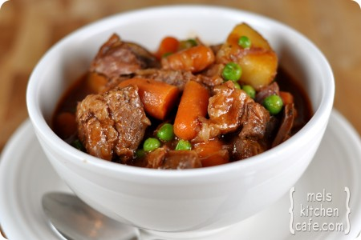

Slide 6
Fish and chips, which were once urban street food eaten from newspaper with salt and malt vinegar, and pies and sausages with mashed potatoes, onions, and gravy, are now matched in popularity by curries from India and Bangladesh, and stir-fries based on Chinese and Thai cuisine. Italian cuisine and French cuisine are also now widely adapted. Britain was also quick to adopt the innovation of fast food from the United States, and continues to absorb culinary ideas from all over the world while at the same time rediscovering its roots in sustainable rural agriculture.

Slide 7
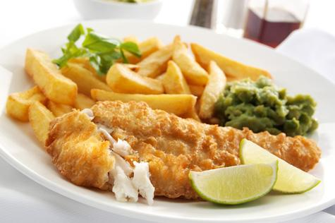
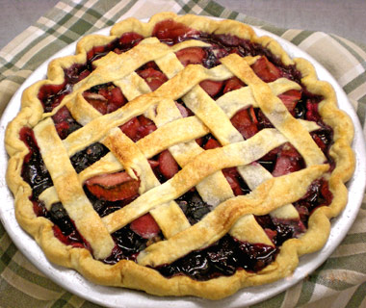
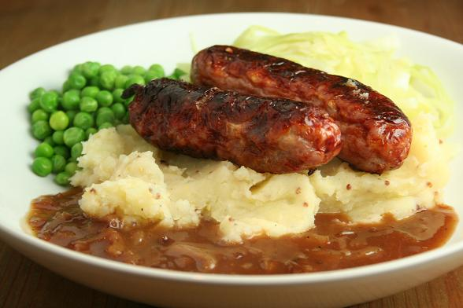

Slide 8
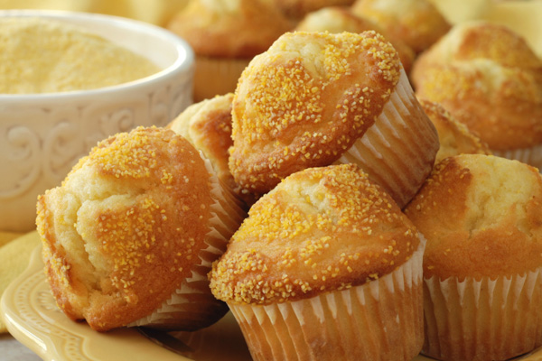
English Muffins
English Muffins should not be mistaken for American Muffins. English muffins are a yeast-based dough as you can see in this English Muffin recipe. They are a delicious tea-time treat, toasted and served warm with butter or filled, they make a lovely sandwich.

Slide 9
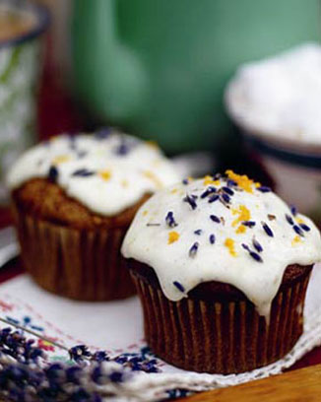
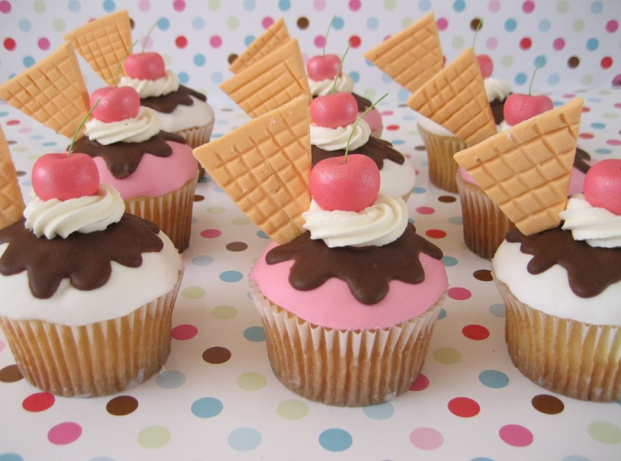
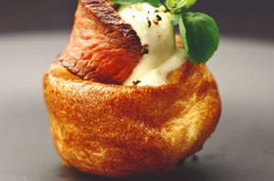
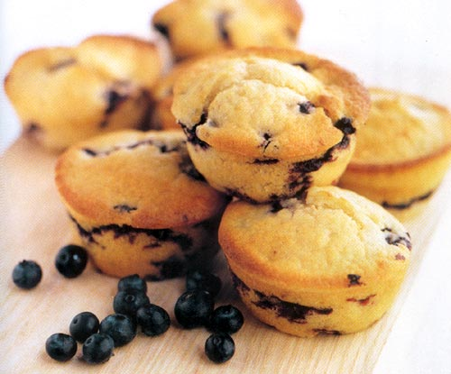

Slide 10
How to make better muffins
They are easy to make and once cooked will keep for several days in an airtight tin.
Prep Time: 2 hours
Cook Time: 15 minutes
Total Time: 2 hours, 15 minutes

Slide 11
Ingredients:
2 cups all purpose flour
1/2 cup granulated sugar
2 tsp baking powder
1/2 tsp baking soda
1/2 tsp salt
3/4 cup well shaken cold buttermilk
3 oz (3/4 stick) unsalted butter, melted
2 large eggs
2 tsp finely grated lemon zest or orange zest
1 tsp pure vanilla extract
1,5 cups blueberries

Slide 12
Preparation:
/All of the ingredients besides the buttermilk should be in room temperature. You can also swap blueberries to any other kind of berries./
Center the rack in the middle of the oven and preheat the oven to 375F. Lightly coat 12 cup standard muffin pan with nonstick spray.

Slide 13
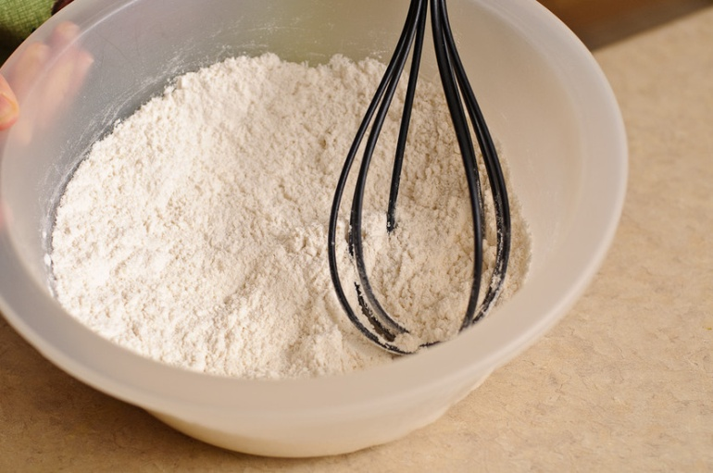
In a medium bowl whisk together dry ingredients: flour, sugar, baking soda, baking powder and salt.

Slide 14
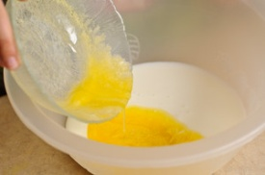
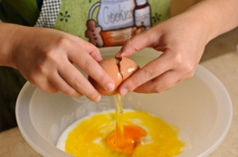
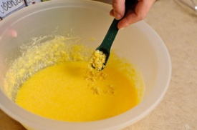
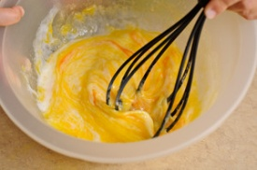
In a separate bowl mix liquid ingredients: buttermilk, luke warm butter, eggs, vanilla and not so liquid lemon zest

Slide 15
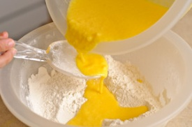
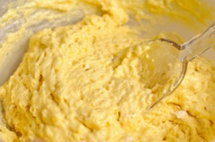
Add the buttermilk mixture to the flour mixture and stir gently with a rubber spatula just until moistened. Do not beat until smooth. Otherwise muffins will have a coarse texture.

Slide 16
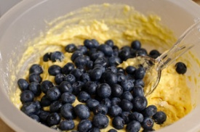
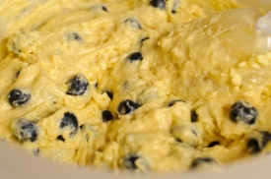
Using the spatula fold in the blueberries. Mix gently a few times just enough to incorporate blueberries into batter.

Slide 17
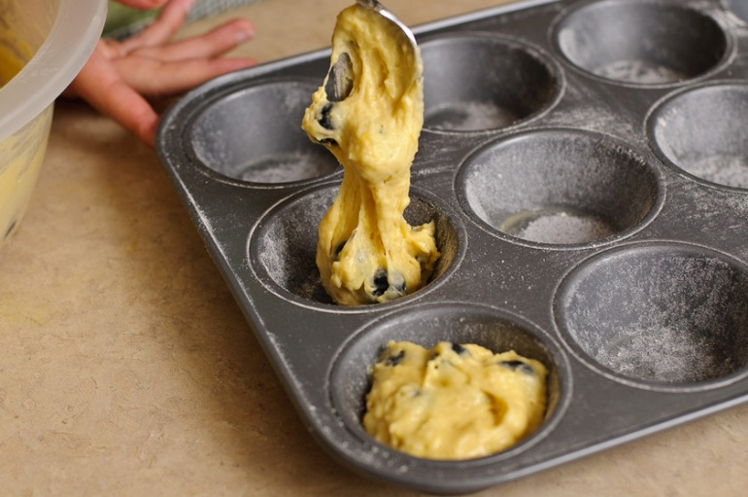
Using a spoon (like I did) or an ice-cream scoop about 2 1/4 inches in diameter fill the muffin cups 3/4 full.

Slide 18
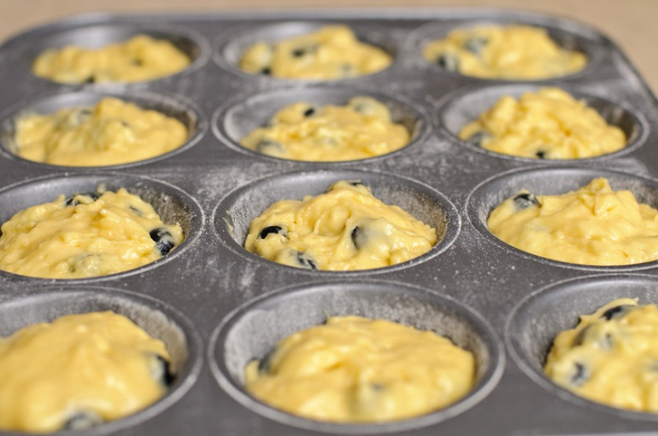
Once evenly placed, put the muffins into the ready oven for about 20 minutes until they are golden and spring back when you press the center of the muffins

Slide 19
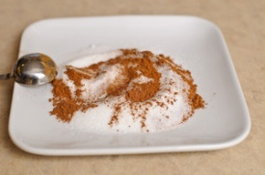
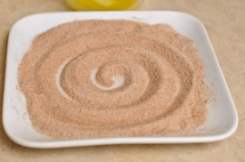
Meanwhile if you decided to do the doughnut topping mix sugar with cinnamon (cardamom optional) and keep it ready until you will need it.

Slide 20
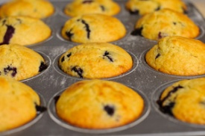
After taking out the muffins from the oven, make sure you give it a rest before handling them further. 10-15 minutes is sufficient enough.

Slide 21
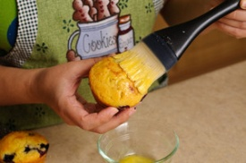
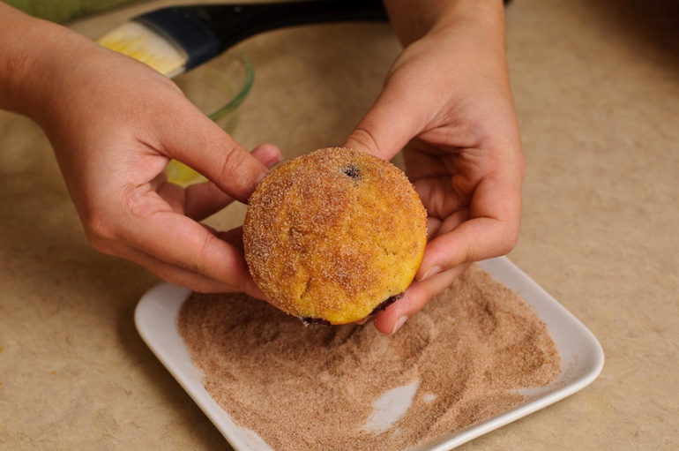
While the muffins are still warm, gently remove them from the pan one at a time. Brush the top of the muffins with the butter (or simply dip the tops in butter) and roll in the cinnamon sugar to coat. Place the muffin on a wire rack to cool them completely.

Slide 23
The end

